Slide 1
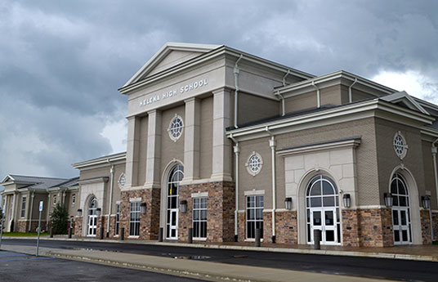
Helena High School
Senior Parent Information
Class of 2017

Slide 2
Contact Information
Senior Administrator – Ashley Bahr
Counselor – Kristen Blanton
Senior Sponsor – Kristy Parker

Slide 3
What to Expect
Senior Fees
Application Fees
Graduation Fees
(Alabama Graduation
Products)
Senior Pictures (Bill Miller)
Senior Fashions
AP, ACT, & SAT Tests
Senior Ads

Slide 4
2016 - 2017 Helena High School Senior Class Important Dates
Sept. 6th - Makeup Senior Portraits
October 19th - Alabama Graduation Products (AGP) Meeting during Pack 60 in the Auditorium; Information on ordering Cap/Gown, invitations and senior souvenirs (no $ just height and weight needed)
November 2nd - Invitations orders to AGP due during lunch - $60 deposit if ordering
November 18th - $70 Senior fee due to Mrs. Parker in A100 (covers graduation venue rental, ceremony expenses, and senior event)
December 2nd - AP Fee due ($92 per class)
January - Prom tickets go on sale (around $45 per ticket if purchased early) Prom is March 11th at the Carriage House at Park Crest

Slide 5
Dates…continued
April 4th - Invitation pick-up during lunch - order balance due to AGP
April 5th - Auditions for those who would like to perform a song at graduation (sign up with Mrs. Parker in A100)
April 26th - Cap/Gown pick up during lunch ($75 due to AGP at delivery)
May 1st - College Decision Day (wear college gear)
May 15th - Awards Day and Senior Event
May 23rd - Graduation Practice at BJCC Concert Hall (load buses at 8:30 a.m.)
May 23rd - Graduation Ceremony at BJCC Concert Hall at 6:30 p.m. (arrive at 5:00 p.m.) (Students will be given 9 tickets each)
Please note that this is a tentative schedule.

Slide 6
College Admissions
The Application Process
4 Year Colleges
Technical Schools
ACT vs. SAT
?
Grade Point Average
How To Apply
When To Apply
Community Colleges
Deadlines
Scholarships

Slide 7
Things to do for college : See handout
Research
Visit
Apply
Complete FASFA
Decide
Notify

Slide 8
Guidance Office Procedures
Requesting A Transcript (online)
Requesting A Letter Of Recommendation
College & Scholarship Announcements (online)
College Visit Procedures (form)
My Future Program

Slide 9
MY FUTURE PROGRAM
Career Exploration
College Private Visits at HHS
Senior College Visits (2)
Job Shadowing Program (1)
College VIP Tours (12th-AU &UA)
College Admissions
Financial Aid
Resume Writing
Senior Interview Day
Senior Presentations
National Decision Day

Slide 10
Once Accepted…then what for Scholarship ?
Start with the College
GPA – usually a 3.5
ACT Scores – vary from one school to another
Check the departmental scholarships at school – pay attention to time frame for these
Local Resources – look at scholarship websites and I will send some through google classroom

Slide 11
Important Websites
AchieveAlabama.org
ACTstudent.org
Collegeboard.com
www.fastweb.com
http://www.chegg.com/scholarships
www.scholarships.com

Slide 12
Types of Scholarships
Merit Based (College web site)
Academic
Leadership
Departmental
Service
Needs Based
www.fasfa.ed.gov
Athletic
www.eligbilitycenter.org/

Slide 13
Merit or Academic Based Scholarships
Determined by the College

Slide 14
DECEMBER 1 Why Important?

Slide 15
Need Based….FAFSA
Grants
Free Money
Do not have to repay
Pell Grant ---- @ $5850.00 per year

Slide 16
Need Based….FAFSA Loans
Stafford LOANS
Will be in the name of the student
Enrolled for 6 hours
Subsidized--- GOVERNMENT pays the interest
Unsubsidized--- student pays the interest
Repay over 10-25 years
6 months after graduation
Based on the income of the student at the time

Slide 17
Needs based…Stafford Loan
1st year $5500.00 maximum
2nd year $6500.00 maximum
3rd year& up $7500.00 maximum
Lower interest rates
Federal Work Study Programs at colleges

Slide 18
How to Qualify
Free Application for Federal Student Aid www. Fafsa.ed.gov
CREATE a Pin number that you will remember ALWAYS
NEW NEW NEW NEW NEW NEW NEW NEW NEW NEW NEW NEW NEW NEW NEW
OCTOBER 1, 2016

Slide 19
Filling out the FAFSA
Sections:
Student demographics
College selections
Dependency status
Parent demographics
Student and part financial information
Social Security number
Notes:
Takes about 45 min to complete
Can save for 45 days
Helpful hints on each page
IRS RETRIEVAL Tool
Determines what family resources are available to pay for college
THE EFC--Expected Family Contribution

Slide 20
Terminology - COA
Cost of Attendance:
Tuition and Fees
Housing
Meal plan
Books and supplies
Entertainment
Transportation
Miscellaneous
Determined by the colleges not the GOVERNMENT

Slide 21
Cost of Attendance - compared
Estimated Cost of Attendance at Public School
Tuition; $11,000.00
Room/Meal: $10,000.00
Books: $1200.00
Personal : $2700.00
Transportation: $2800.00
Total Cost: $27,000.00
Estimated Cost of Attendance in Private School
Tuition: $33,500.00
Living Expenses: $11, 000.00
Other: $3200.00
Total Cost: $47,700.00

Slide 22
Definition of Need
Cost of Attendance (COA)
– Expected Family Contribution (EFC)
______________________
= Financial Need

Slide 23
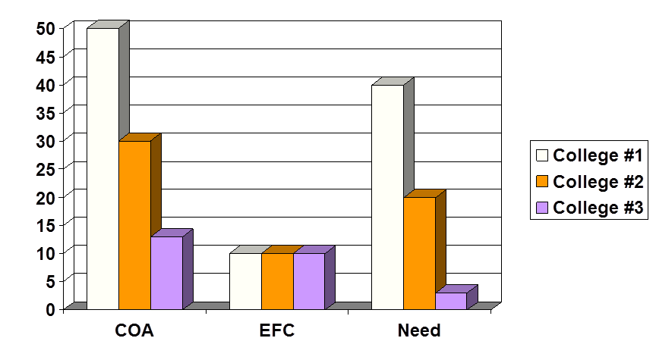
How much will you need?

Slide 24
Financial Aid Office
Determine eligibility after receiving information from FAFSA or CSS Profile
Create an aid package
Send award letter to student that includes
COA
Student Need
Types and Amount of Aid Offered
How and When Aid Will Be Dispersed
Student Employment Conditions
Terms and Conditions of Aid Offer

Slide 25
Other Sources of Funding
Resident Assistant Benefits
Ambassador Programs
ROTC/Military Options
PACT/529 Plans
Personal Loans/Banks
University Payment Plans

Slide 26
May 1st
You must accept financial aid and scholarships by this deadline

Slide 27
It is your child’s responsibility to do most of the work!

Slide 28
?

