Slide 1
Freshman Parent Academy
Class of 2027
Welcome, Parents!

Slide 2
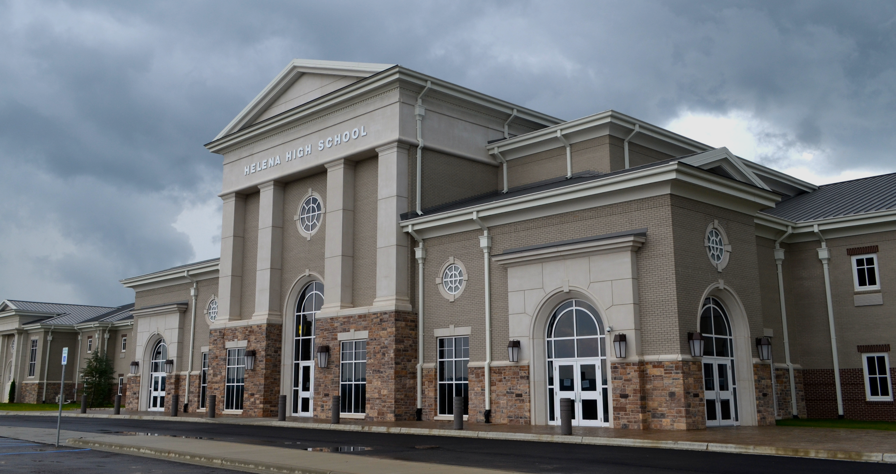
Administration
Principal - Mrs. Bahr
Assistant Principal - Mrs. McGrew (9th & 12th)
Assistant Principal - Mr. McCaleb (10th & 11th)
Counselors
Mrs. Blanton - 12th grade
Mr. Palmer - 10th & 11th grade
Mrs. Parker - 9th grade
School Resource Officers
Officer Black & Officer Roberts
9th grade:
Mrs. McGrew: bmcgrew@shelbyed.org
Mrs. Parker: jparker@shelbyed.org

Slide 3
Main Office Staff
Mrs. Emerson
Mrs. Chumley
Mrs. Parker
Mrs. Cook
Mrs. Lancaster
Registrar
Bookkeeper
Health Room/Nurse
HHS
205-682-3650
Secretary
Secretary

Slide 4
Bell Schedule
REGULAR SCHEDULE |  | ACTIVITY SCHEDULE
8:00 8:10-8:59 9:04-9:57 10:02-10:51 10:51-11:51 11:51-12:40 12:45-1:34 1:39-2:28 2:33-3:22 | First Bell 1st Period 2nd Period 3rd Period Pack 60 5th Period 6th Period 7th Period 8th Period | 8:00 8:10-8:55 9:00-9:45 9:50-10:35 10:35-11:35 11:35-12:20 12:25-1:10 1:15-2:00 2:05-2:50 2:50-3:22 | First Bell 1st Period 2nd Period 3rd Period Pack 60 5th Period 6th Period 7th Period 8th Period Activity

Slide 5
Academics
Alabama High School Diploma Requirements
4 English
4 History
4 Math
4 Science
1 Physical Education/Beginning Kinesiology (2 yrs marching band; 1 year Show Choir)
½ credit health (1 semester)
3 electives (Career Technology and/or Fine Arts and/or Foreign Language)
3.5 additional credits (other electives, sports, etc.)
= total 24 credits
1 credit = 1 academic credit; ½ credit = 1 semester
Must pass all required courses and participate in the state assessment to graduate!

Slide 6
Class of 2027 Math Pathway
Option 1 (If haven’t taken Accelerated Math 7 and Accelerated Math 8) | Option 2 (Taken Accelerated Math 7 and Accelerated Math 8) | Option 3 (AP Pathway if taken Accelerated Math 7 and Accelerated Math 8)
-Geometry w/ Data Analysis -Pre-AP Geometry w/ Data Analysis | -Geometry w/ Data Analysis - Pre-AP Geometry w/ Data Analysis | -Geometry w/ Data Analysis -Pre-AP Geometry w/ Data Analysis
-Algebra I with Probability | -Algebra II with Statistics -Pre-AP Algebra II with Statistics | -Algebra II with Statistics -Pre-AP Algebra II with Statistics
-Algebra II with Statistics -Pre-AP Algebra II with Statistics | -Pre Calculus -Pre-AP Pre-Calculus -Computer Science AP (Prerequisite - Algebra II/Statistics) -Computer Science A AP (Prerequisite - Computer Science AP) -Approved CTE Math Course | -Pre Calculus -Pre-AP Pre-Calculus -Computer Science AP (Prerequisite - Algebra II/Statistics) -Computer Science A AP (Prerequisite - Computer Science AP)
-Pre Calculus -Math Modeling -Applications of Finite Math -Approved CTE Math Course -Dual Enrollment I/II | -Pre Calculus -Pre-AP Pre-Calculus -Math Modeling -Computer Science AP (Prerequisite - Algebra II/Statistics) -Computer Science A AP (Prerequisite - Computer Science AP) -Statistics AP -Approved CTE Math Course -Dual Enrollment I/II | -Calculus AP -Calculus BC, AP -Computer Science AP -Computer Science A AP (Prerequisite = Computer Science AP) -Statistics AP
9th
10th
11th
12th

Slide 7
Class of 2027 Science Pathway
 | Option 1 | Option 2 | Option 3
9th | -Biology | -Biology | -Biology -Pre-AP Biology
10th | -Physical Science | -Physical Science | -Chemistry (c/r Alg II w/Statistics) -Pre-AP Chemistry (c/r Alg II w/Statistics)
11th | -Chemistry (c/r Alg II w/Statistics) -Environmental Science -Forensics and Criminal Investigations -Physics -Human Anatomy and Physiology | -Chemistry (c/r Alg II w/Statistics) -Pre-AP Chemistry -Human Anatomy and Physiology -Pre-AP Human Anatomy and Physiology | -Physics -Physics AP -Human Anatomy and Physiology Honors -Biology AP -Chemistry AP -Environmental Science -Environmental Science AP
12th | -Chemistry (c/r Alg II w/Statistics) -Environmental Science -Physics -Human Anatomy and Physiology -Forensics and Criminal Investigations -Dual Enrollment I/II | -Human Anatomy and Physiology -Pre-AP Human Anatomy and Physiology -Physics -Biology AP -Environmental Science -Human Anatomy and Physiology -Dual Enrollment I/II | -Pre-AP Human Anatomy and Physiology -Physics -Physics AP -Biology AP -Chemistry AP -Environmental Science AP -Forensics and Criminal Investigations

Slide 8
Class of 2027 English Pathway
 | Option
9th | -English 9 -Pre-AP English 1
10th | -English 10 -Pre-AP English 2
11th | -English 11 -English Language AP -Dual Enrollment: English Composition I English Composition II
12th | -English 12 -English Literature AP -Dual Enrollment: English Composition I English Composition II

Slide 9
Class of 2027 History Pathway
 | Option
9th | -World History: 1500 to the Present -World History AP
10th | -US History 10 -US History 10 AP
11th | -US History 11 -US History 11 AP (Year two)
12th | -Economics/Government -AP Macroeconomics/US Gov/Politics AP -Dual Enrollment I/II

Slide 10
Advanced Placement (AP) Pre-AP Classes
College level class taken at HHS
AP Credit universally recognized because of consistent standard of rigor
Fee for AP Exam is around $90 per class
College credit is dependent upon passing score on the AP exam
Offer “weight” to high school GPA
Create opportunity to graduate from college early
Accelerated high school level class taken at HHS
Offer “weight” to high school GPA
Faster pace of instruction
More in depth coverage of material
Regular Courses | AP Courses
A = 4.0 | A = 5.0
B = 3.0 | B = 4.0
C = 2.0 | C = 3.0
D = 1.0 | D = 2.0
F = 0.0 | F = 0.0
Regular Courses | Pre-AP Courses
A = 4.0 | A = 4.5
B = 3.0 | B = 3.5
C = 2.0 | C = 2.5
D = 1.0 | D = 1.5
F = 0.0 | F = 0.0

Slide 11
Shelby County Advanced Academic Endorsement
Follows all of the requirements for the Alabama high school diploma and the following:
Minimum math of Algebra II with Statistics
Chemistry
Foreign language (2 years, same foreign language)
½ credit of Fine Art
Minimum of 2 AP courses with one in a core content or the equivalent (Dual Enrollment, Dual Credit or IB)

Slide 12
How Can I Keep Up?
PowerSchool Login
ListServ - bottom of HHS main page
Schoology Login
Schedule Change Requests: Due Friday
Class of 2027 GroupAccess Code
KN2X-MFJ6-B78NQ

Slide 13
Pack60: Tuesday - Friday (10:51 - 11:51)
Monday - LEAD
Schedule a time to go to the teacher’s class
Clubs/Class Meetings
Make up a quiz/test
Intervention
Complete classwork and/or homework
Study for tests/quizzes.
Monday: Students will make a PLAN for Pack60 in their LEAD class

Slide 14
From the teachers…
Check PowerSchool/Schoology daily
Have conversations about being respectful & kind
If taking Spanish: SPEAK as much Spanish as possible
It is OK to make mistakes; it is how we learn
ASK for help at the soonest indication that it is needed. Waiting to get help only makes it worse
IF interested in chaperoning trips or helping out with special events, please contact the teacher to see what is available that year as it helps in planning
Encourage your student to get Involved!

