Slide 1
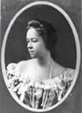
Georgia Douglas Johnson
Poet

Slide 2
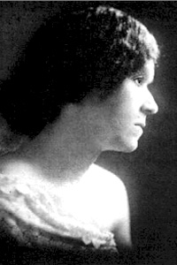
Who
Georgia Blanche Douglas Camp Johnson, better known as Georgia Douglas Johnson (September 10, 1880 – May 14, 1966), was an American poet, one of the earliest African-American female playwrights,[1] and a member of the Harlem Renaissance.

Slide 3
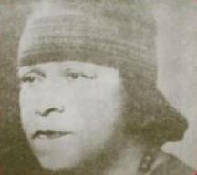
Born
Johnson was born in Atlanta to Laura Douglas and George Camp[2] (her mother's last name is listed in other sources as Jackson).[3][4] Her mother was of African and Native American descent, and her father was of African-American and English heritage.[4]

Slide 4
Hometown
Much of Johnson's childhood was spent in Rome, Georgia. She received her education in both Rome and Atlanta, where she excelled in reading, recitations and physical education. She also taught herself to play the violin, which developed into a lifelong love of music that appears in her plays, which make distinct use of sacred music.[5]

Slide 5
Career
Johnson graduated from Atlanta University's Normal School 1896.[3] She taught school in Marietta, Georgia. She left her teaching career to pursue her interest in music in 1902, attending Oberlin Conservatory of Music in Ohio. She wrote music from 1898 until 1959. After studying in Oberlin Johnson returned to Atlanta, where she became assistant principal in a public school.[1]

Slide 6
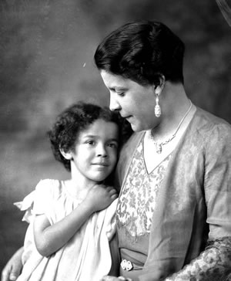
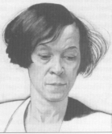
Marriage
On September 28, 1903, Johnson married Henry Lincoln Johnson, an Atlanta lawyer and prominent Republican party member. They had two sons, Henry Lincoln Johnson, Jr., and Peter Douglas Johnson (d. 1957). Johnson claimed her husband was not very supportive of her writing, preferring her be to a home-maker instead.[2] Her husband's job as a lawyer forced them to live in Washington, D.C., away from the literary center in Harlem. He died in 1925 when she was aged 45 and she was left to take care of their sons, who were teenagers at the time.

Slide 7
After husband…
.[6] Even though her husband often criticized her career as a writer, she published two poems dedicated to him: "The Heart of a Woman" (1918) and "Bronze" (1922).[7] Johnson lived in Washington for the last 50 years of her life. After her husband died in 1925, she struggled at first with some temporary jobs. As a gesture of appreciation for her husband's loyalty and service to the Republican party, President Calvin Coolidge appointed Johnson as the Commissioner of Conciliation in the Department of Labor.

Slide 8
Plays
Johnson wrote about 28 plays. Plumes was published under the pen name John Temple.[2] Many of her plays were never published because of her gender and race.[1] Gloria Hull is credited with the rediscovery of many of Johnson's plays.[6]

Slide 9
Plays
The 28 plays that she wrote were divided into four sections: "Primitive Life Plays", "Plays of Average Negro Life", "Lynching Plays" and "Radio Plays". Several of her plays are lost. In 1926, Johnson's play "Blue Blood" won honorable mention in the Opportunity drama contest. Her play "Plumes" also won in the same competition in 1927.[7] Johnson was one of the only women whose work was published in Alain Locke's anthology Plays of Negro Life: A Source-Book of Native American Drama. Johnson's typescripts for ten of her plays are in collections in academic institutions.[1]

Slide 10
Key Advocate against ALM
Although Johnson spoke out against race inequity as a whole, she is more known as a key advocate in the anti-lynching movement as well as a pioneering member of the lynching drama tradition. Her activism is primarily expressed through her plays, first appearing in the play Sunday Morning in the South. This outspoken, dramatic writing about racial violence is sometimes credited with her obscurity as a playwright since such topics were not considered appropriate for a woman at that time.[5]

Slide 11
Anti-Lynching
Unlike many African-American playwrights, Johnson refused to give her plays a happy ending since she did not feel it was a realistic outcome. As a result, Johnson had difficulty getting plays published.[2] Though she was involved in the NAACP's anti-lynching campaigns of 1936 and 1938,[5] the NAACP refused to produce many of her plays claiming they gave a feeling of hopelessness.[8] Johnson was also a member of the Writers League Against Lynching, which included Countée Cullen, James Weldon Johnson, Jessie Fauset, and Alain Locke. The organization sought a federal anti-lynching bill.[5]

Slide 12
Salons
Soon after her husband's death, Johnson began to host what became 40 years of weekly "Saturday Salons", for friends and authors, including Langston Hughes, Jean Toomer, Anne Spencer, Richard Bruce Nugent, Alain Locke, Jessie Redmon Fauset, Angelina Weld Grimké and Eulalie Spence — all major contributors to the New Negro Movement, which is better known today as the Harlem Renaissance.[3]

Slide 13
Death
She was especially close to the writer Angelina Grimké. Johnson called her home the "Half Way House" for friends traveling, and a place where they "could freely discuss politics and personal opinions" and where those with no money and no place to stay would be welcome.[2]
She died in Washington, D.C., in 1966.
In September 2009, it was announced that Johnson would be inducted into the Georgia Writers Hall of Fame.[9]

