Slide 1
Writing With Art Wednesdays
Mrs. Culver
Creative Writing

Slide 2
Write about the artwork you see. You cannot just write “I like it or I hate it.”

Slide 3
More things to think about
Write down the possible meaning of the image
Identify characters and their motives. Who are they and what do they want? Explain how you know based on details.
Pretend that you are in the image, and describe what you see, smell, feel, and hear.
Describe the details that are just outside of the image, the ones we can’t see.
Introduce dialogue into your story. What are they saying?
Sequence the events of the story. What happened five minutes before this scene, what is happening now, and what happens five minutes later? How do you know?
Write from the perspective of one of the characters in the image.
Explain who is the protagonist and antagonist. What is their conflict?

Slide 4
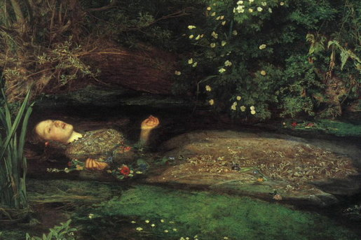
Wednesday, August 19, 2015

Slide 5
What did you write?
Share with class.

Slide 6
The Facts: What’s it really about?
John Everett Millais is the painter.
http://www.cleanvideosearch.com/media/action/yt/watch?v=I2M7U8eCeHA

