Slide 1

“The Lottery”
Shirley Jackson
Notes on the story

Slide 2
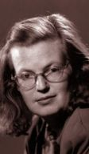
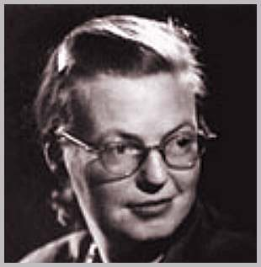
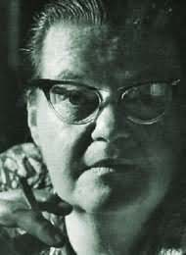
Shirley Jackson
Shirley Jackson (December 14, 1919 - August 8, 1965) was an American author who wrote short stories and novels. Her most famous work is her short story "The Lottery," which combines a peaceful small-town-America setting with a horrific shock ending. The tone of most of her works is odd and macabre, with an impending sense of doom, often framed by very ordinary settings and characters.

Slide 3
First Publication and Reaction
1948 in the New Yorker magazine
“The Lottery is reported to have generated more negative letters from readers than any other story previously published by the magazine. Many cancelled their subscriptions to the magazine
Readers were offended by the work and its suggestion that evil could be so easily and commonly carried out. They felt the stoning was a pointless, arbitrary, violent sacrifice.

Slide 4
First Publication and Reaction
Some people actually called to see where the town was so that they could go and watch the lottery.
Shirley Jackson received over 300 letters that summer alone—”I can count only thirteen that spoke kindly to me. Even my own mother scolded me: ‘Dad and I did not care at all for your story…it does seem, dear, that this gloomy kind of story is what all you young people think about these days. Why don’t you write something to cheer people up?’”

Slide 5
Shirley Jackson’s Response
Generally, she refused to explain the meaning of the story.
She did once tell a journalist: “I suppose I hoped, by setting a particularly brutal rite in the present and in my own village, to shock the readers with a graphic demonstration of the pointless violence and general inhumanity of their own lives [but] I gather that in some cases the mind just rebels. The number of people who expected Mrs. Hutchinson to win a Bendix washer at the end would amaze you.”

Slide 6
Ancient Ritual Sacrifice
In ancient Athens, Greece, Athenians believed that human sacrifice promised fertile crops.
By transferring one's sins to persons or animals and then sacrificing them, people believed that their sins would be eliminated, a process that has been termed "scapegoat"
A similar ritual sacrifice occurs with Tessie Hutchinson.
This explains the village member's remark, “Lottery in June, corn be heavy soon.”

Slide 7
Scapegoat
Scapegoat- This is a person, group, or thing assigned responsibility for the perceived faults of a given society. The term has many roots in the ancient world. In modern times the holocaust is often pointed to as an example of scapegoating by which 6 millions Jews were killed under direction of Adolf Hitler. Hitler played on popular sentiment in his country at the time by blaming Jews for the loss of the first world war and the economic woes of Germany.

Slide 8

Historical Context
“The Lottery” was written in 1948.
After World War II Americans tended to imitate those around them rather than follow their own separate paths.
Encouraging this conformity was the spread of television, which broadcast the same set of images to Americans scattered through the country.
In politics, people feared the spread of Communism, leading to the Un-American Activities Committee, the Hollywood blacklist, and by 1950, McCarthy’s Communist “witch hunt”
In the story, the townspeople are swept away by the tide of conformity, and the lottery goes ahead as always.

Slide 9
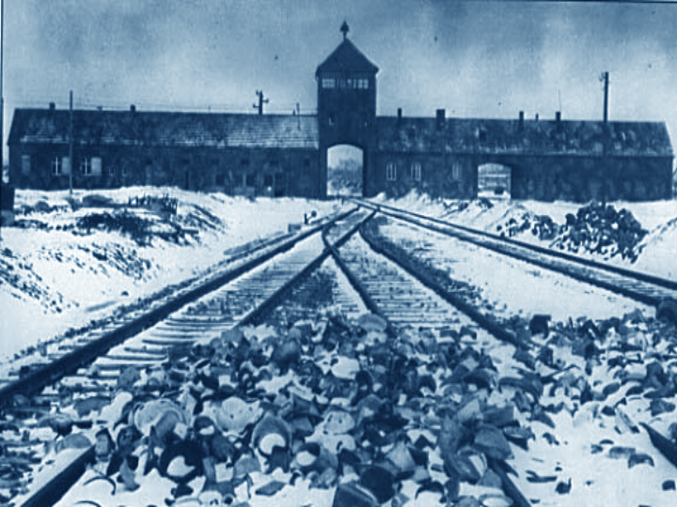
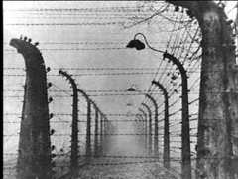
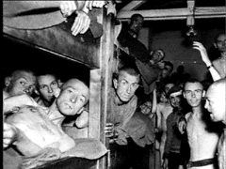
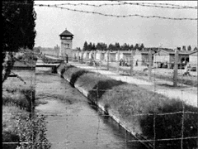
Historical Context
By 1943 news of the Nazi concentration camps had finally reached America.
A number of Americans responded with horror and concern that communities could have stood by and silently allowed the Holocaust to occur.
Jackson hints at a similar situation in her story when the townspeople are unable to fully question or prevent the brutal lottery practice, and in fact, participate in it.

Slide 10
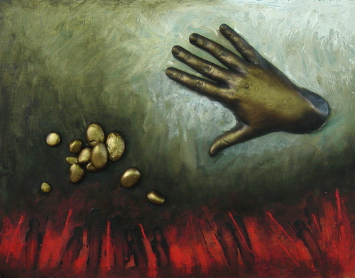
Biblical Allusion
“The Lottery” alludes to the Biblical story in which Jesus frees an adulterous woman, directing who is without sin to cast the first stone. No one throws stones at her.
Unfortunately, no one in “The Lottery” stops this stoning. Tessie becomes their scapegoat; she pays for their sins.

Slide 11
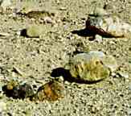

Ritual without meaning
Because there has "always been a lottery“, the villagers feel compelled to continue this horrifying tradition.
They focus on its gruesome nature, for they "still remembered to use stones" even after they have "forgotten the ritual and lost the original black box“.
The story may be saying that society tends toward violence instead of society's need for civilized traditions.

Slide 12


Mob violence
The horrible actions exhibited in groups (such as the stoning of Mrs. Hutchinson) do not take place on the individual level, for individually such action would be called "murder."
On the group level, people classify their atrocious act simply as "ritual."
When Mrs. Hutchinson arrives at the ceremony late, she chats sociably with Mrs. Delacroix. But after Mrs. Hutchinson falls victim to the lottery selection, Mrs. Delacroix chooses a "stone so large" that she must pick it up with both hands.
On the individual level, the two women regard each other as friends, but on the group level, they betray that relationship, satisfying the mob mentality.

Slide 13

Symbolism
Black:
The color for death, mourning, punishment
The black box used to draw lots and the slip of paper with a black mark pointing out the 'winner' are mentioned too frequently to be coincidental.

Slide 14
Symbolism
Black box:
Coffin? Evil secret hidden away?
Black spot on paper:
Sin? A “black mark” on one’s record is negative; black mark: unclean?

Slide 15
Symbolism
Black Box–
The box is old; the paint is peeling, and the wood is splintered. This condition reflects the fading of the tradition in other villages as well as the villager's questioning of the lottery in this village.
However, they will not replace the box, just like they will not stop the lottery.

Slide 16
Symbolism
The Lottery Itself:
Symbolizes any number of social problems that we blindly continue even though they are outdated
The setting:
no specific name/place indicates this is anytown, USA; the contrast of the town with the ritual helps build suspense

Slide 17
Symbolism: Names
Summers: the season of summer is associated with youth, strength, growth, prime of life, warmth, leisure, prosperity, happiness, blooming, blossoming
Graves : the obvious grave = place of entombment/death
Grave = serious; hints that the lottery may not be a frivolous contest (“Mr. Graves said gravely”)
Critics have said that Jackson creates balance by having Mr. Summers and Mr. Graves share in the responsibilities of the ritual: Life brings death, and death recycles life.

Slide 18
Parable
Many believe “The Lottery” to be a modern-day parable—a story that presents a moral lesson through characters who represent ideas.
The focus in a parable is not to develop character or other typical plot elements.
You’re not told the lesson in a parable—you are to figure out what the lesson is.

Slide 19
Themes
(almost done…)
Acts of violence, hatred, murder are not acceptable just because many people participate
Society is reluctant to reject outdated traditions, ideas, rules, laws, and practices.
People are not all good or all evil but a mixture of both.
Horrifying acts of violence can take place anywhere at anytime, and they can be committed by the most ordinary people.
Following the crowd can have disastrous consequences.
The unexamined life is not worth living.
Many more ideas/themes can be applied to “The Lottery”

Slide 20
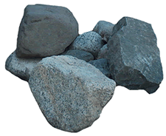
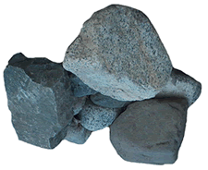
“The Lottery”:
More than you expected, right…?
End of presentation.
(Finally)

