Slide 1
Argumentative Writing
Anca T-Hummel
NBCT-AYA/ELA
taus-hummel@phoenixunion.org
Joanna Nichols
I.L. English
jnichols@phoenixunion.org

Slide 2
ARGUMENTATIVE ESSAY
The argumentative essay
is a genre of writing that requires you to:
1. investigate a topic;
2. collect, generate, and evaluate evidence; and
3. establish a position on the topic in a concise manner.

Slide 3
Everyday Life Example
When we argue:
Bob: That was a lame movie!
Suzy: Why?
Bob: The special effects were bad. The monsters were obviously fake.
Suzy: I thought the movie was good because the acting was believable.
Bob’s bad response: You are an idiot.
Bob’s good response: Yes the acting was good but the horrible special effects were too distracting and caused some awkward moments.
Claim
Evidence
Counterclaim
Refutation

Slide 4
PERSUASION versus ARGUMENTATION
Persuasion: The action or fact of persuading someone or of being persuaded to do or believe something.
Argumentation: The process of establishing a claim and then proving it with the use of logical reasoning, examples, and research.

Slide 5
Difference between
Persuasive and Argumentative Essay
A persuasive essay
May make a claim based on opinion
May not take opposing ideas into account
Persuades by appealing to the audience’s emotion or by relying on the character or credentials of the writer
Emotion-based
An argumentative essay
Makes claims based on factual evidence (research)
Makes counterclaims – the author takes opposing views into account.
Neutralizes or “defeats” serious opposing ideas
Convinces audience through the merit and rationality of the claim and proofs offered
Logic-based

Slide 6
Elements of Argumentation
Argument/Claim
An argument states a claim and supports it with reasons and evidence from sources.
Arguing your side makes you the proponent.

Slide 7
Elements of Argumentation
Counterargument/Counterclaim
An argument that stands in opposition to your argument/claim. The counterargument is your opponent’s (the other side’s) argument that tries to explains why you are wrong.

Slide 8
Elements of Argumentation
Refutation
Simply disproving an opposing argument. It is an important skill because it is how a writer successfully convinces the audience of the validity of his/her own argument.

Slide 9
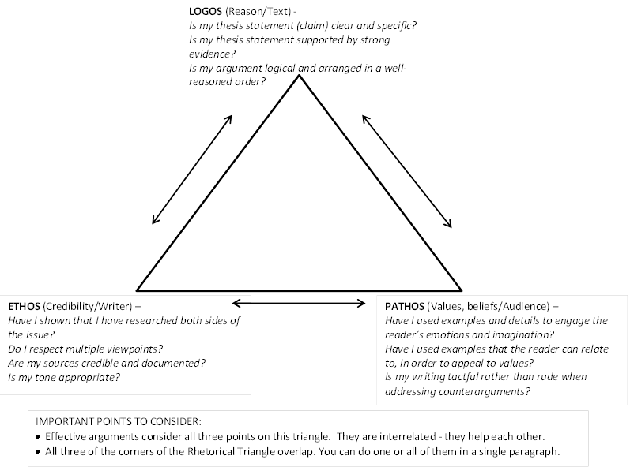
The Rhetorical Triangle – remember me?
Don’t forget to incorporate elements of ethos, pathos, and logos.

Slide 10
Why is Organization Important in Argument Writing?
Guides an audience through your reasoning process
Offers a clear explanation of each argued point
Demonstrates the credibility of the writer

Slide 11
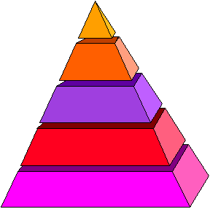
Organizing Your Argument
Title
Introduction
    Thesis statement
Body Paragraphs
    Constructing Topic Sentences
    Building Main Points
    Countering the Opposition
Conclusion

Slide 12
Title: Why You Need One
Introduces the topic of discussion to the audience
Generates reader interest in the argument

Slide 13
Creating a Title
Try to grab attention by:
  offering a provocative image
  picking up on words or examples offered in the body or conclusion of the paper
  asking a question
Avoid titles that are too general or lack character

Slide 14
Practice
Look at the Model Argument Essay.
Read the title.
Turn to your partner and discuss the effectiveness of the title.
Be prepared to share.

Slide 15
What is an Introduction?
Acquaints the reader with the topic and purpose of the paper
Generates the audience’s interest in the topic
Offers a plan for the ensuing argument:
Introduction: Tell them what you’re going to tell them
Body: Tell them
Conclusion: Tell them what you told them

Slide 16
Methods for Constructing an Introduction
personal anecdote
example-real or hypothetical
question
quotation
shocking statistics
striking image

Slide 17

Practice
Look at the Model Argument Essay.
Read the Introduction.
After reading the introduction, do you know what the writer plans to tell you in his argument essay?
Share with a different partner and explain your position.

Slide 18
What is a Thesis Statement?
The MOST IMPORTANT SENTENCE in your paper
Lets the reader know the main idea of the paper
Answers the question: “What am I trying to prove?”
Not a factual statement, but a claim that has to be proven throughout the paper

Slide 19

Thesis Practice
Which thesis statement is the most effective for an argument about the need for V-chips in television sets?
Parents, often too busy to watch television shows with their families, can monitor their children’s viewing habits with the aid of the V-chip.
To help parents monitor their children’s viewing habits, the V-chip should be a required feature for television sets sold in the U.S.
This paper will describe a V-chip and examine the uses of the V-chip in American-made television sets.

Slide 20
Practice
Take your Model Argument Essay.
Close read the first paragraph.
Identify and highlight the Thesis Statement
Does the thesis statement
- Let you know the main idea of the paper?
- Answer the question: “What am I trying to prove?”
- Is the thesis statement not a factual statement, but a claim that has to be proven throughout the paper?
Be prepared to share your answer with your partner or class.

Slide 21
Body Paragraphs and Topic Sentences
Body paragraphs build upon the claims made in the introductory paragraph(s).
Organize with the use of topic sentences that illustrate the main idea of each paragraph.
Offering a brief explanation of the history or recent developments of topic within the early body paragraphs can help the audience to become familiarized with your topic and the complexity of the issue.

Slide 22
Body Paragraphs
Paragraphs may be ordered in several ways, depending upon the topic and purpose of your argument:
    General to specific information
    Most important point to least important point
    Weakest claim to strongest claim

Slide 23
Offering a Counterargument
Addressing the claims of the opposition is an important component in building a convincing argument.
It demonstrates your credibility as a writer – you have researched multiple sides of the argument and have come to an informed decision.
It shows you have considered other points of view – that other points of view are valid and reasonable.

Slide 24
Effective Counterarguments
Consider your audience when you address the counterargument.
Conceding to some of your opposition’s concerns can demonstrate respect for their opinions.
Remain tactful yet firm.
  Using rude or deprecating language can cause your audience to reject your position without carefully considering your claims.

Slide 25

Placement of a Counterargument
Counterarguments may be located at various locations within your body paragraphs.
You may choose to:
  build each of your main points as a contrast to oppositional claims.
  offer a counterargument after you have articulated your main claims.

Slide 26
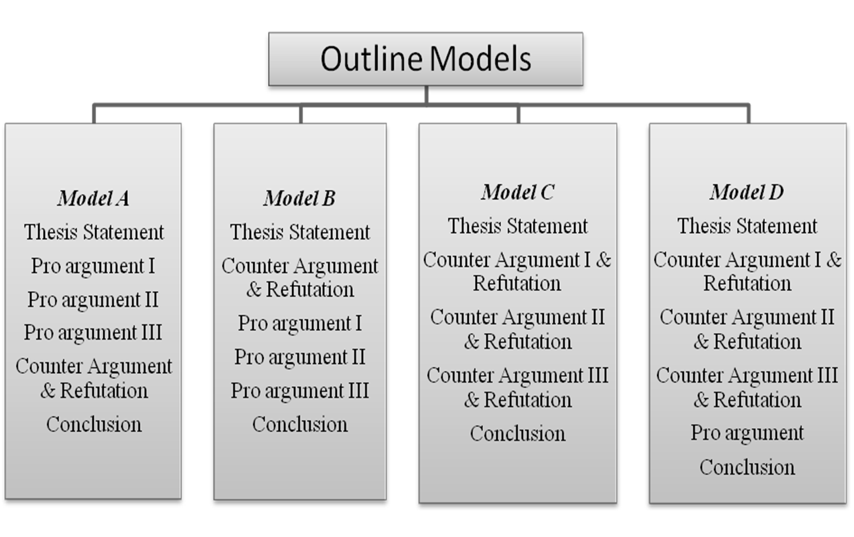
Organizing Ideas into an Outline
moving beyond the 5-paragraph essay

Slide 27
Research in Body Paragraphs
Researched material can aid you in proving the claims of your argument and disproving oppositional claims.
Be sure to use your research to support the claims made in your topic sentences – make your research work to prove your argument.

Slide 28
Conclusion
Your conclusion should reemphasize the main points made in your paper.
You may choose to reiterate a call to action or speculate on the future of your topic, when appropriate.
Avoid raising new claims in your conclusion.
Introduction: Tell them what you’re going to tell them
Body: Tell them
Conclusion: Tell them what you told them

Slide 29
Recap: Organizing Your Argument
Title
Introduction
    Thesis statement
Body Paragraphs
    Constructing Topic Sentences
    Building Main Points
    Countering the Opposition
Conclusion

Slide 30
Key Terms to Learn
2
1. a person who disagrees with something and speaks against it
2. the act or process of forming reasons, drawing conclusions, and applying them to a case in discussion
3. point or statement that supports one’s ideas and/or thesis
4. point or statement in opposition to the argument being made in a written document or speech
5. the process of discrediting the arguments that oppose your thesis statement
6. someone who argues in favor of something; advocate
Argumentation ___
Refutation _____
Proponent _____
Opponent _____
Counter Argument (CON) ____
Pro Argument (PRO) _____
5
6
1
4
3

Slide 31
Practice
Close Read the Model Argument Essay. While marking the text, specifically highlight the
  Claim
  Counterarguments/Counterclaims
  Refutation
Does the conclusion meet the requirements? What changes, if any, would you make?

Slide 32
Check the web site: http://owl.english.purdue.edu
for further info.

