Slide 1
SUCCESS
“Success is peace of mind that comes with the self-satisfaction in knowing you did your best to become the best that you were capable of becoming.”
- John Wooden

Slide 2
COACHES
Mel Hackbarth
Jeff Renfro
Stewart Civils
Anthony Franks
Jason Neeley
Jacob Odle
Nic Owen
Josh Taylor
Josh Wallis

Slide 3
B.A.S.E
Belief
Athleticism
Skill
Effort

Slide 4
BELIEVE
“For me success is not about the wins and losses. It’s about helping these young fellas BE the best versions of themselves on and off the field.”
- Ted Lasso

Slide 5
ATHLETICISM

Slide 6
TRAINING
TBA

Slide 7
SKILL
Running
Blocking
Tackling
Throwing
Catching
Football IQ

Slide 8
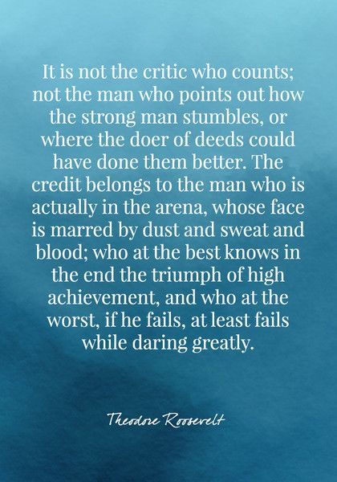
Effort

Slide 9
B.a.s.E CAMP
Testing and Training: TBA
Spring Camp: May 6-17
Dragonfly Max: Must be 100%

Slide 10
Participation Requirements
Dragonfly: Must be 100% under 2023-2024 school year. If not 100% - will not be allowed to participate
Physical must have the following or it will be rejected
Athlete name at the top
Clearance status clearly indicated
Dr. signature
Date next to Dr. Signature
8th - 6:45
Front side must be filled out and parent and athlete signature
Sportsmanship must be in athletes name or will be rejected

Slide 11
Communication tool
Will receive email to log-in

Slide 12
SUMMER
Training Starting June 18 – July 25
(Tuesday – Thursday / 8:00-9:30) @ OMMS
Dead Week: July 15-20 – No Training

Slide 13
FALL
Practice: Begins Monday
Monday –Wednesday (3:15-5:15)
Friday: Film / Extra Work ( 3:15 – 4:15 )
Games: Thursday
7th - 5:00
8th - 6:45
Cost:
Football: 210.00
Meals: 85.00 (7th only)
Booster: 132.00
Spirit Pack: TBD

Slide 14
Football Committee
10 Members
5 - 7th
5 - 8th
Parent Liaison
Equipment / Facilities
Game Day
Media
Fundraising

Slide 15
NEEDS
HELMETS
SHOULDERPADS
UNIFORMS
FIELD PAINT
SPORTS BUILDING

Slide 16
QUESTIONS
?

