Slide 1
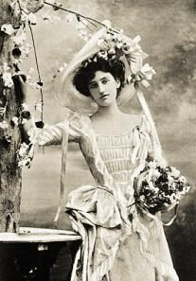
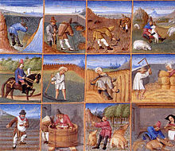
Costumes of the Middle Ages
By:
Taryn Wilson

Slide 2
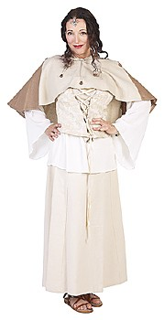
Their clothing
In Medieval Europe, as in the Roman period, most people wore loose linen or wool tunics like big baggy t-shirts. But clothing did become more complicated in the Middle Ages, and more used to distinguish men and women of different professions from each other.
http://www.historyforkids.org/learn/medieval/clothing/

Slide 3
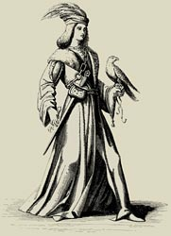
Men’s clothing
Men mostly wore tunics down to their knees, though old men and monks wore their tunics down to the ground, and so did kings and noblemen for parties and ceremonies. Men sometimes also wore wool pants under their tunics. Wearing pants was originally a Germanic idea, and the Romans disapproved of it. But it gradually caught on anyway, especially among men who rode horses and in colder areas. Other men, especially noblemen, wore tights under their tunics.

Slide 4
Women’s clothing
During the 1200s AD, women in Spain also learned from Egyptian women how to knit wool instead of only weaving it. By the 1400s, women were knitting in northern Europe too. Knitting was much faster than weaving, and also produced nice warm stockings that fit well, though they wore out quickly and needed to be darned. Knitting wasn't so exciting in Egypt and southern Europe where it was warm, but in northern Europe, where the Little Ice Age was bringing colder and colder weather, knitting slowly became very important.

Slide 5
The history of middle ages clothing
The history of Middle Ages clothing provides details of the Sumptuary Laws and an overview of Medieval fashion through the ages of the period. The Sumptuary Laws distinguished seven social categories and made members of each class easily distinguished by their clothing. A history of clothing is detailed in a timeline charting the history of fashion through the Medieval era of the Middle Ages. An overview of the major changes in dress and clothing are detailed in the link to Medieval fashion.

Slide 6
Middle ages clothing – worn by different people
The following links provide interesting facts and information about the fashion and clothes worn by different social classes throughout the Medieval period. From the 11th through the 14th centuries, medieval clothing varied according to the social standing of the people. The clothing worn by nobility and upper classes was clearly different than that of the lower class. Medieval clothes provided information about the status of the person wearing them. The clothing and fashion during the Medieval era of the Middle Ages was dominated and highly influenced by the Kings and Queens of the era. Only the wealthy could dress in fashionable clothes.

Slide 7
Middle ages clothing in Europe
Amongst European nations, during the Middle Ages, there was always one common standard of fashion and clothing , which varied from time to time according to the particular custom of each country, and according to the peculiarities of each race. Each European country would imitate the fashions and clothing of another but still manage to retain its own identity. In Italy, for instance, clothing and dress always maintained a certain character of grandeur, ever recalling the fact that the influence of antiquity was not quite lost. In Germany and Switzerland, clothing and garments had generally a heavy and massive appearance; in Holland, still more so. England uniformly studied a kind of instinctive elegance and propriety in clothing. It is a curious fact that Spain invariably partook of the heaviness of clothing peculiar to Germany because the Gothic element still prevailed there. France was fickle and capricious, always ready to borrow from every quarter any style of clothing which pleased her.

