Slide 1
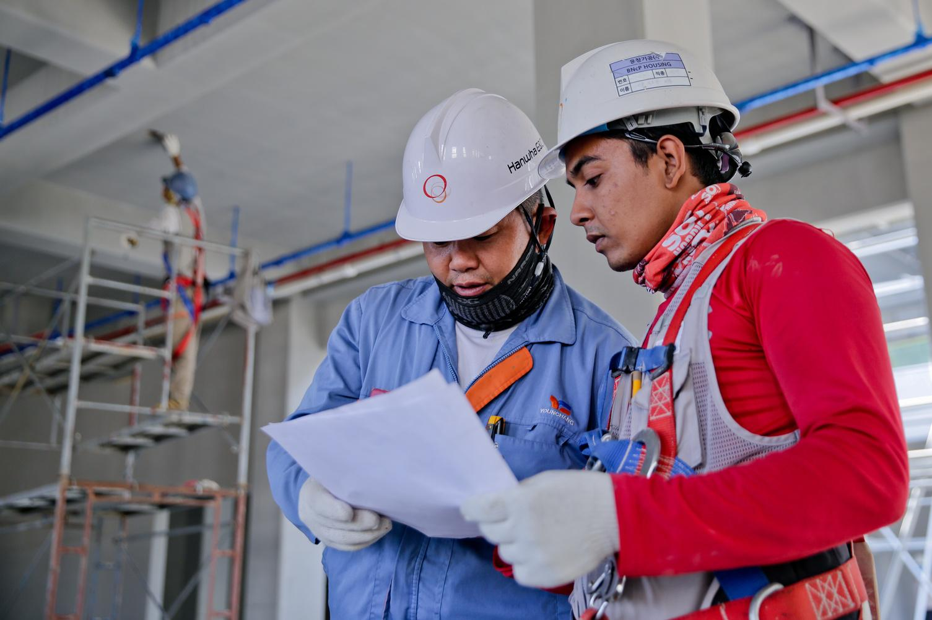
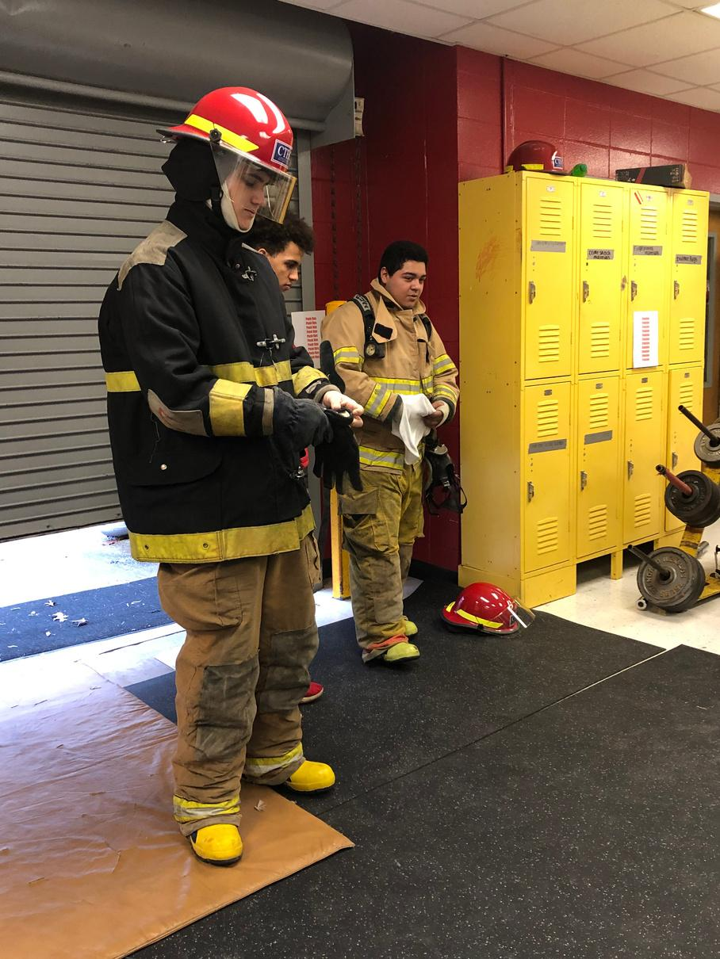
CAREER TECHNICAL EDUCATION CENTER
PREPARING STUDENTS FOR A WIDE RANGE OF HIGH-WAGE, HIGH-SKILL, HIGH-DEMAND CAREERS
Janice Maddox
CTEC Counselor

Slide 2
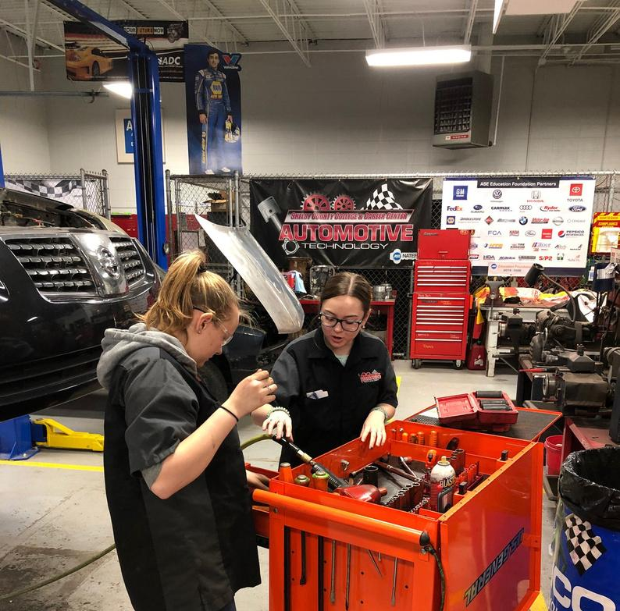
What is Career and Technical Education?
Education programs that specialize in skilled trades, applied sciences, modern technologies and career preparation.

Slide 3
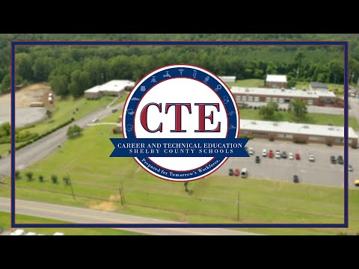

Slide 4
WHY CTEC?
Everyone has to take electives, so why not learn a skill, earn a credential and get hands on experience that qualifies you for jobs right out of high school or that look good on your resume when applying for college, scholarships, medical school, etc…?
Small classes (12-15 students) and low stress environment
Job opportunities/internships/field trips/guest speakers/mock interviews/apprenticeships - Pre-COVID19
Skills that you can use for your personal benefit and save yourself money down the road
Plan “B” for students that have a Plan “A” to go to college but the plan doesn’t work out or the job market changes, it is also a great way to pay for college.
Applied curriculum and experiences in a simulated workplace environment to better prepare students to be college and career ready
Opportunities for students to join nationwide organizations and competitions
Notes:
"Credentials" often refer to academic or educational qualifications, such as degrees or diplomas that you have completed or partially-completed. "Credentials" can also refer to occupational qualifications, such as professional certificates or work experience.

Slide 5
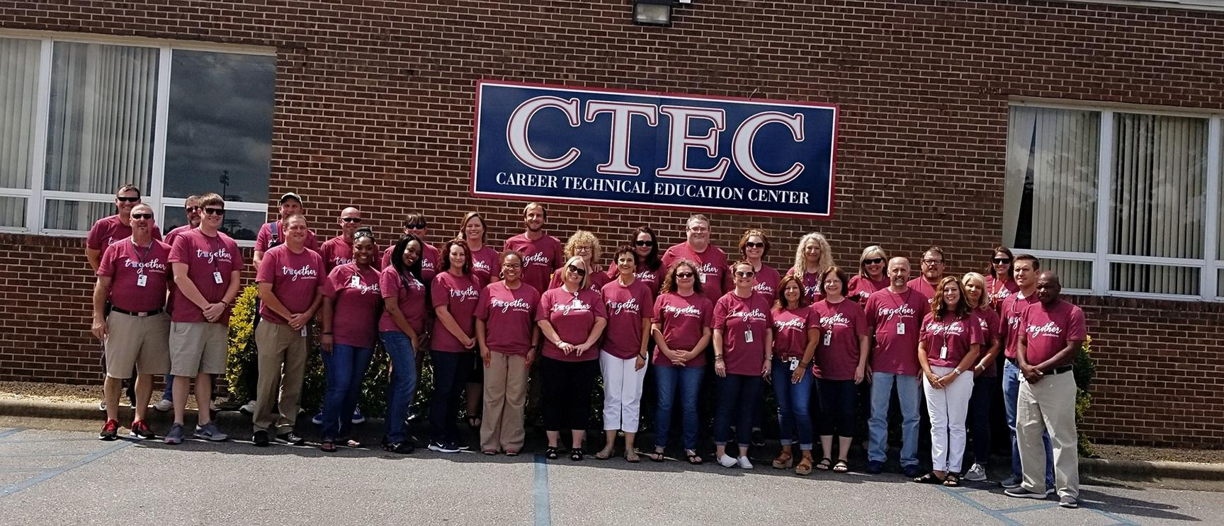
CTEC PROGRAMS
*Automotive Technology *Healthcare Science
*Biomedical Science *Plumbing
*Collision Repair *Public Service
*Construction Technology *Robotics
*Cosmetology *Welding
*Culinary Arts

Slide 6
AUTOMOTIVE TECHNOLOGY
Students learn to inspect, diagnose, maintain, and repair cars and light trucks of all makes and models.
Possible credentials/certifications: ACDelco, ASE, Ford and Subaru
The median salary in Alabama is $45,000

Slide 7
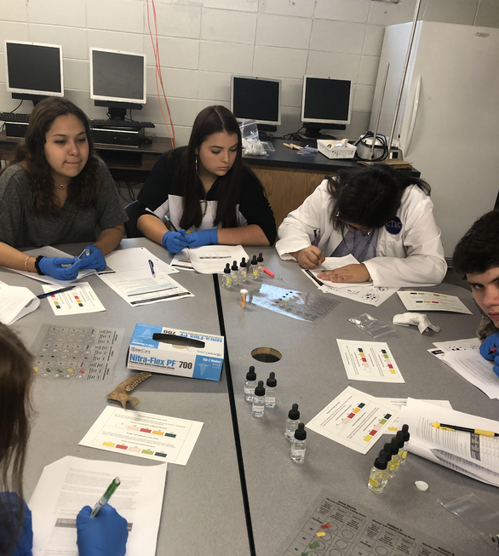
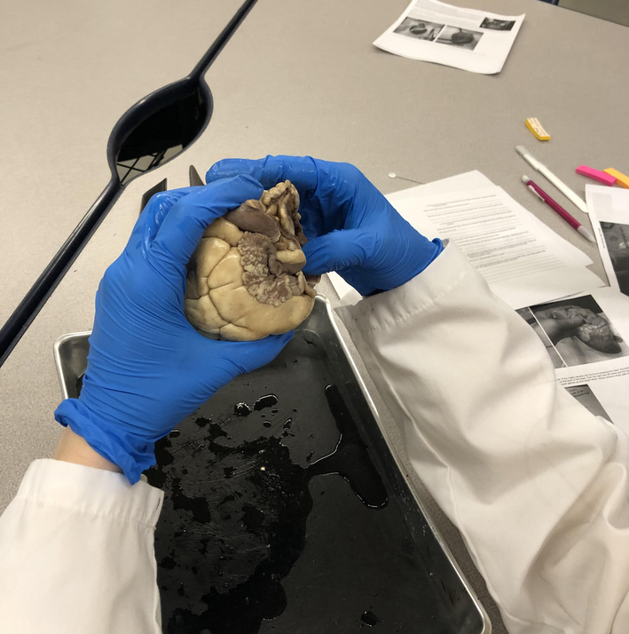
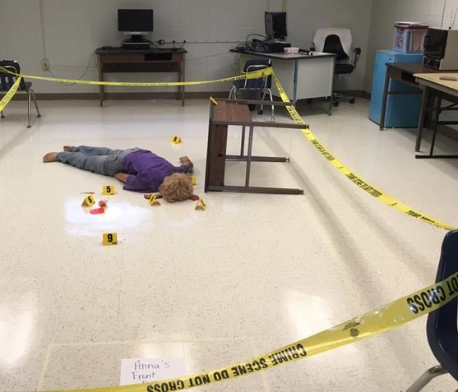
BIOMEDICAL SCIENCE
Students will investigate and study the concepts of human medicine, physiology, genetics, microbiology, and public health.
Students can receive an 11th/12th grade science credit for Forensics and Criminal Investigations, Human Body Structures/Functions (same as Anatomy and Physiology) and Introduction to Biotechnology.
Possible credential/certification: (CCMA) Certified Clinical Medical Assistant
The median salary in Alabama for medical scientists is $89,160.

Slide 8
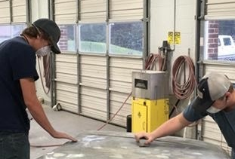
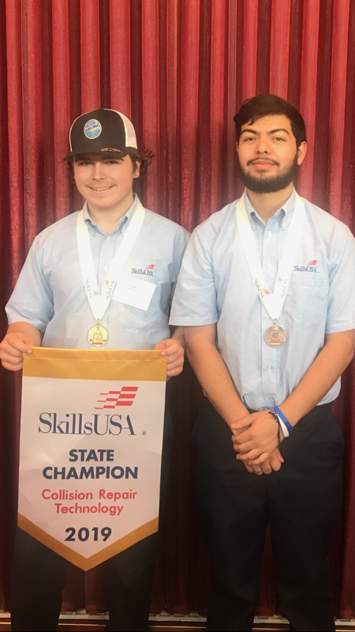
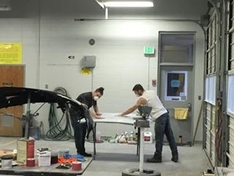
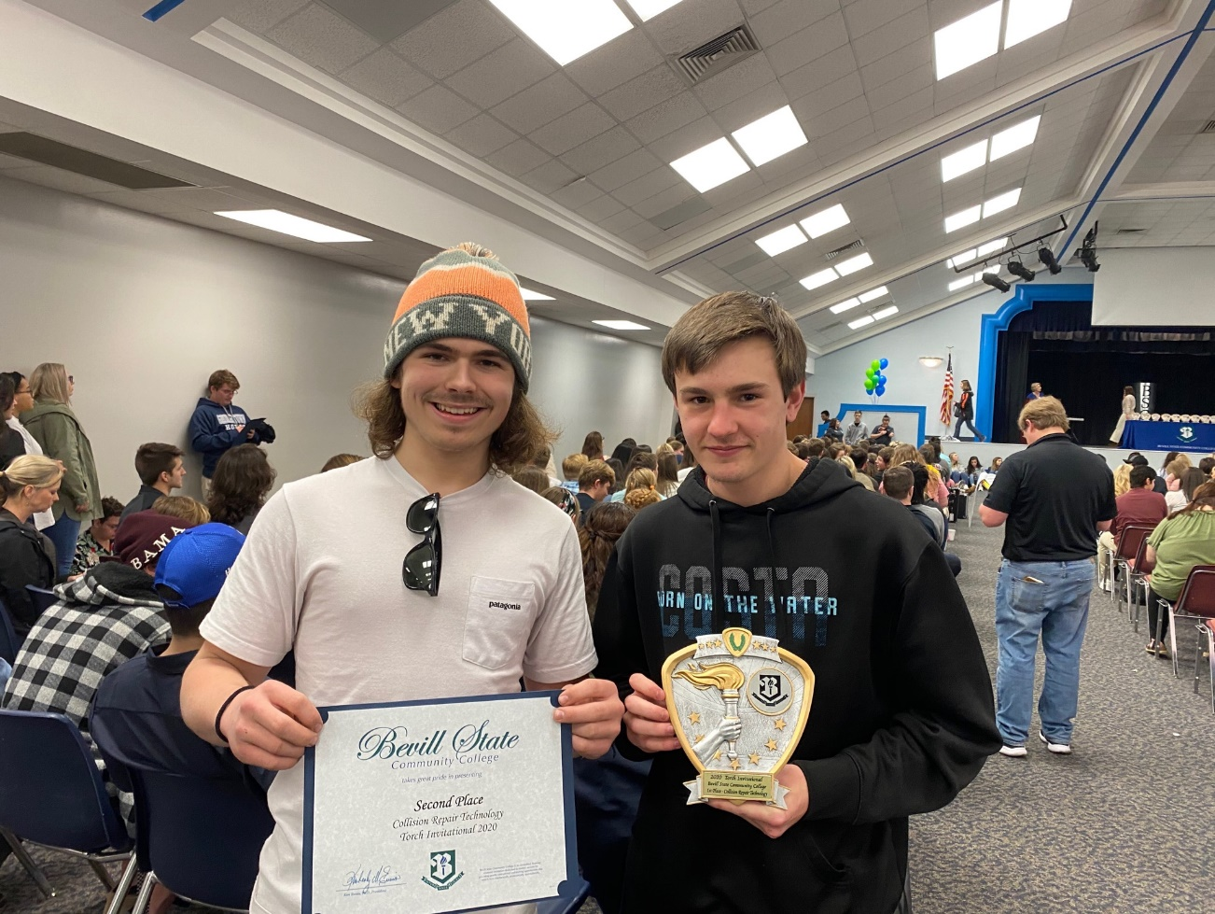
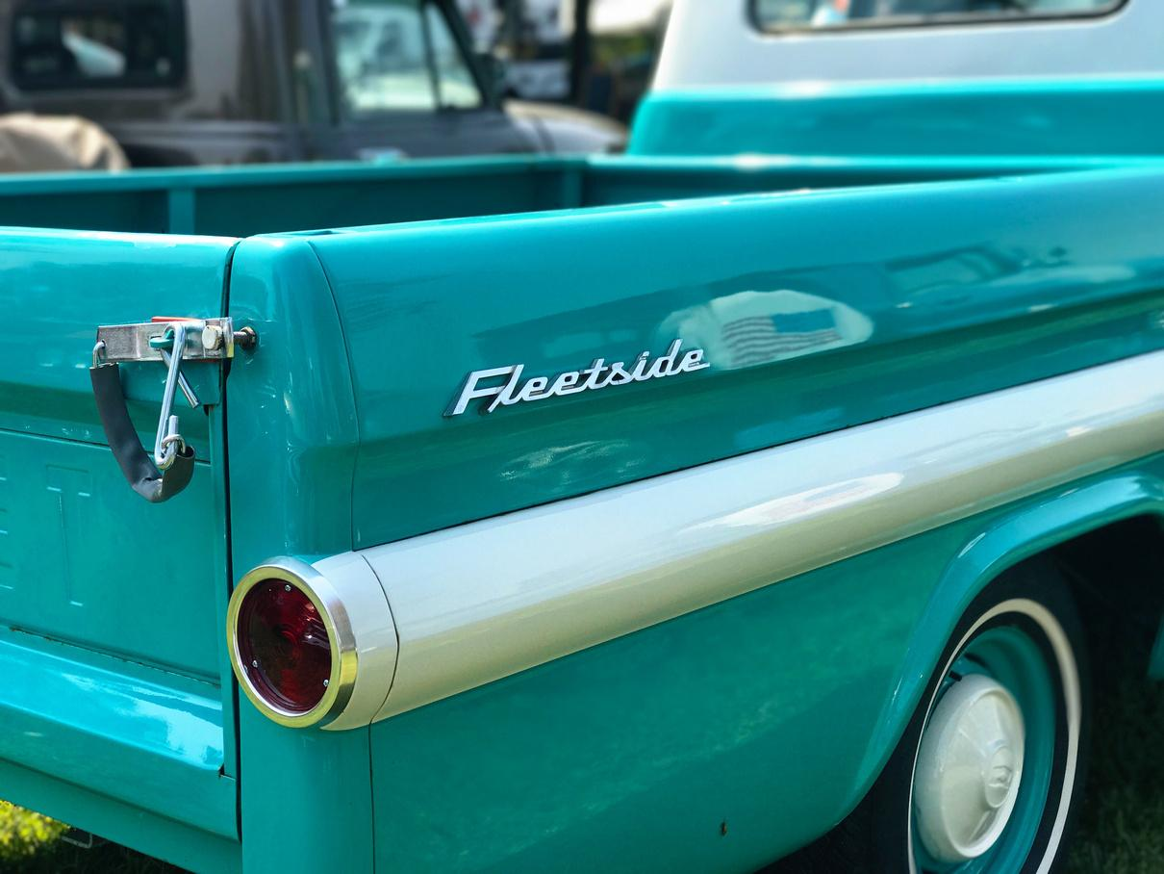
COLLISION REPAIR
Students will receive training in basic body repair and refinishing techniques, structural/non-structural repair as well as application of the latest refinishing products available.
Possible certifications/credentials: I-Car program (3)
The average salary in Alabama is $41,000 and can exceed $58,000.

Slide 9
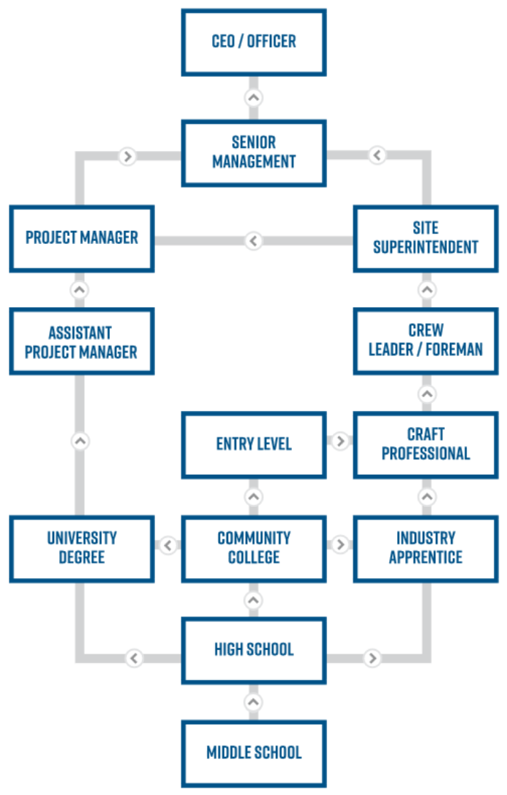
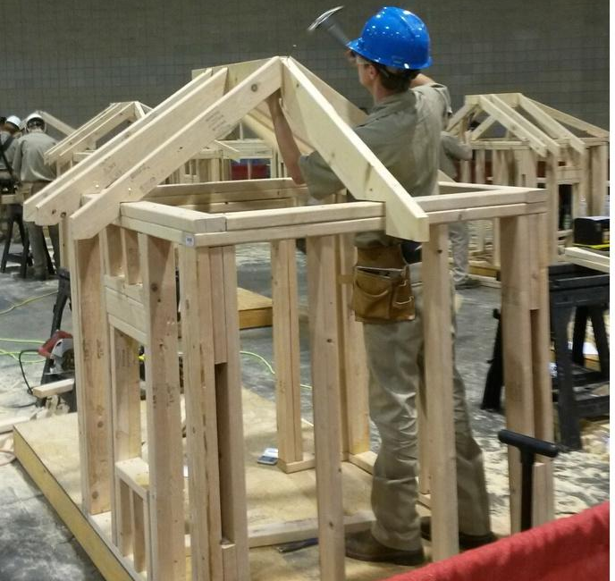
CONSTRUCTION TECHNOLOGY
Construction courses provide trainees with knowledge and principles of carpentry, masonry, electrical work, site preparation, and interior finishing. Students will become skilled in different phases of a construction projects and be able to interpret construction drawings.
Possible Credentials/Certifications: NCCER (National Center for Construction Education and Research) - Core, Carpentry Level One/Two Carpentry and OSHA 10

Slide 10
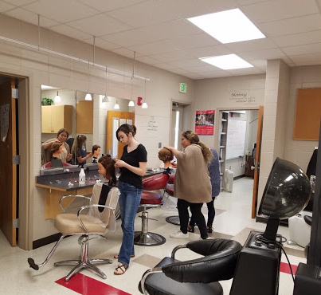
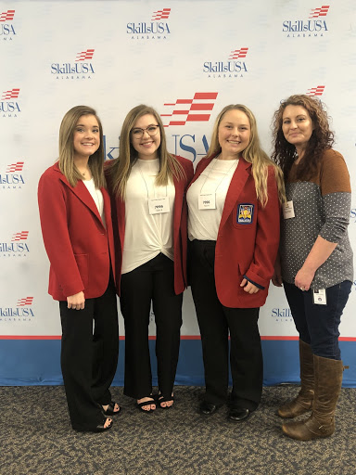
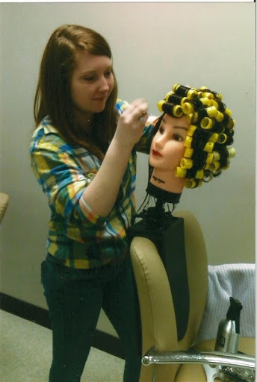
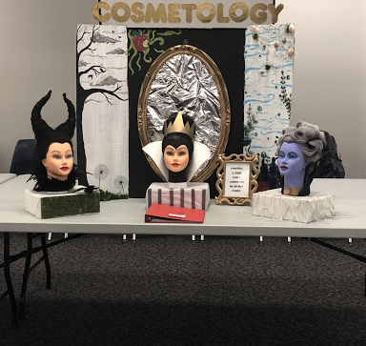
COSMETOLOGY
Students learn how to provide basic service in: shampooing, cutting, hair styling, manicuring, permanent waving, hair coloring, barbering, wigs, makeup, sanitation/sterilization and salon management.
The curriculum is designed to comply with the standards of the State Board of Cosmetology which requires a person to have a social security card to get licensed. The hours (560) that you earn while in the program can be applied to the hours that you have to complete in local Cosmetology programs.
Alabama’s average salary is $39,000. Income can exceed $150,000 depending on the area of the business and clientele.

Slide 11
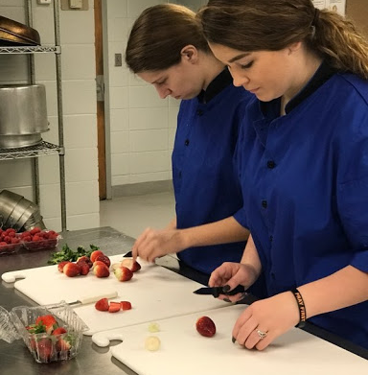
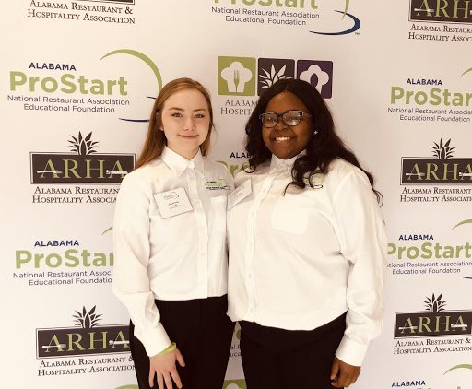
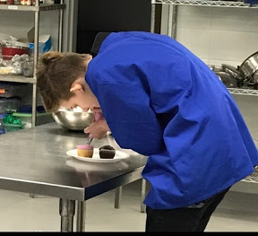
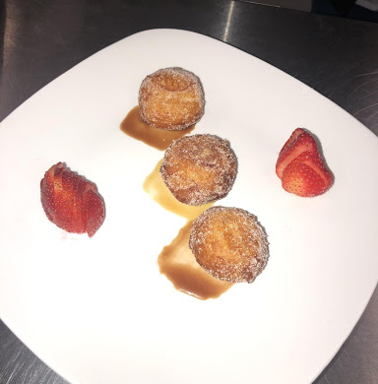
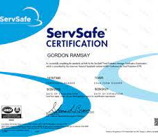
CULINARY & HOSPITALITY
Students learn basic food production, management, and service activities. Emphasis is placed on sanitation, safety, and basic food preparation.
Skills in mathematics/measurement, communication, creative thinking and entrepreneurship are reinforced in this course.
Possible credential/certification: ServSafe
The average salary in Alabama is $45,000. Starting pay is $27,560 and can exceed $84,000.

Slide 12
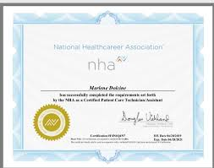
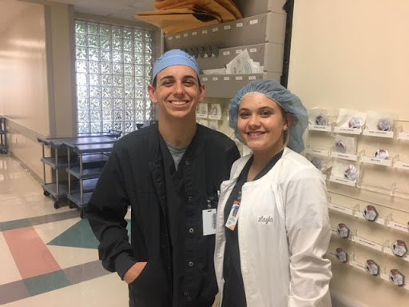
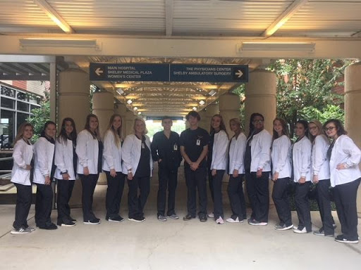
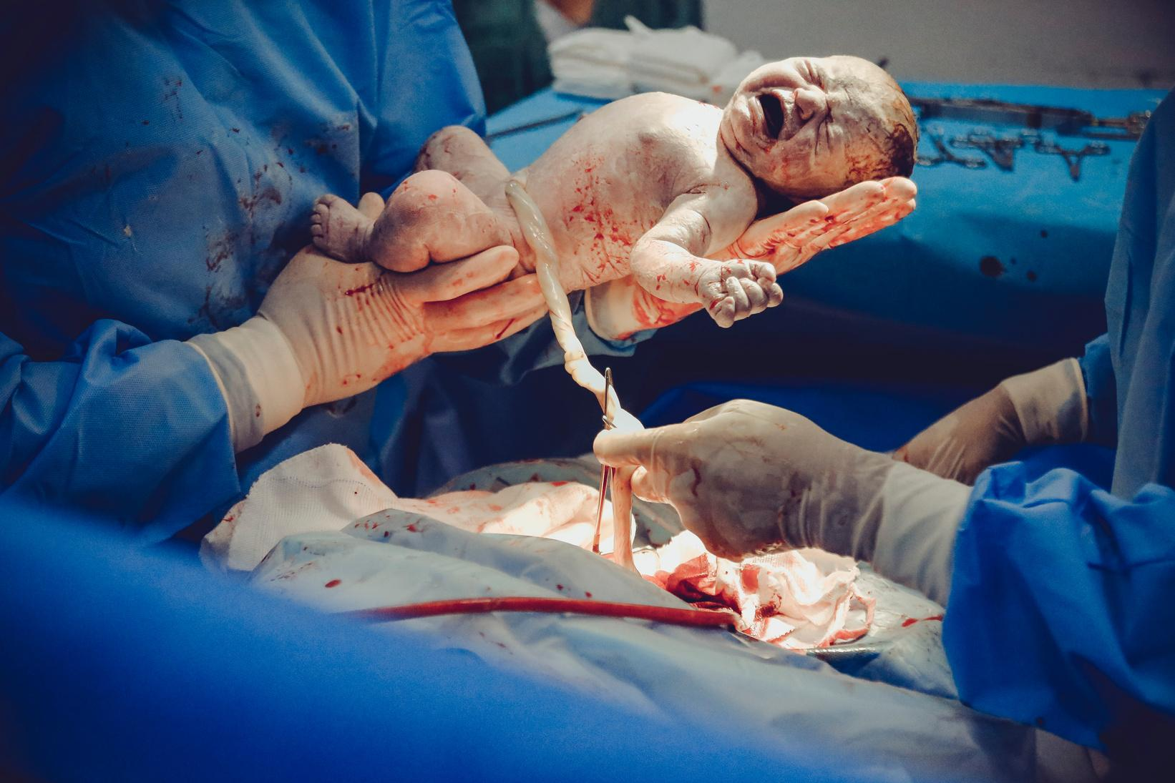
HEALTHCARE SCIENCE
Students learn foundational skills and knowledge related to all health science occupations including, but not limited to: nursing, respiratory therapy, physical therapy, surgical technology, dentistry, orthodontist, veterinary, and emergency medical technician.
Possible credentials/certifications: Certified EKG Technician, Patient Care Technician and First Aid/CPR.
Must have at least a 3.0 GPA and B average in Math and Science.
The average salary in Alabama is $49,000. Depending on certifications or degrees earned, the salary can exceed $80,000.

Slide 13
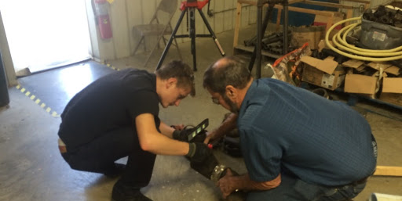
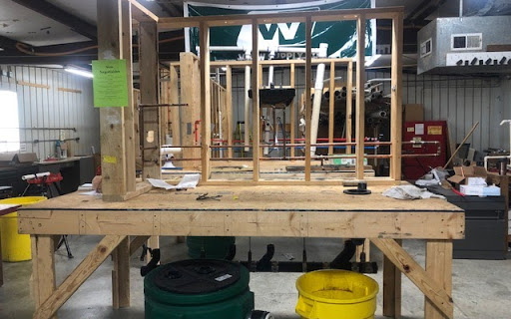
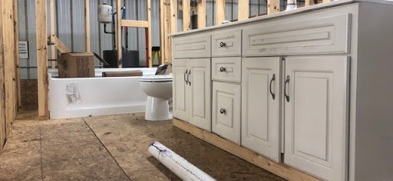
PLUMBING
This program is designed to help students understand the basic fundamental principles of plumbing and pipelining which includes maintenance, repair, construction plumbing and lawn irrigation systems.
Possible credentials/certifications:
OSHA 10, NCCER Core and can sit for Journeyman’s test at the end of two years.
There will be 83,000 jobs available within the next 5 years due to retirements and new construction. The median annual salary in Alabama is over $43,000. The pay range is $27,040 to $58,250 and above.

Slide 14
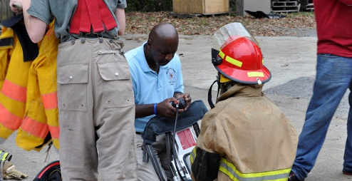
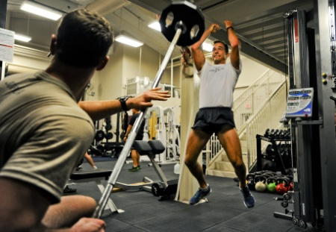
PUBLIC SERVICE ACADEMY
Students learn entry-level skills in a variety of public safety and public service careers such as law enforcement, paramedics, fire protection, forestry, and civil service.
Physical fitness training/competitions
Extensive role playing and training with a virtual program similar to Call of Duty
Opportunity for Dual Enrollment/Dual Credit for Emergency Services at Jefferson State.
Students have the opportunity to become CPR and First Aid Certified
The average Alabama salary is $40,000 and can exceed $90,000 depending on your ranking/education.

Slide 15
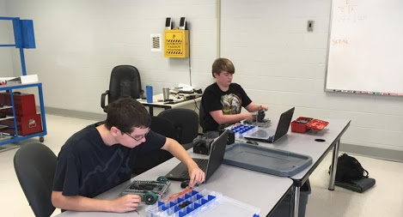
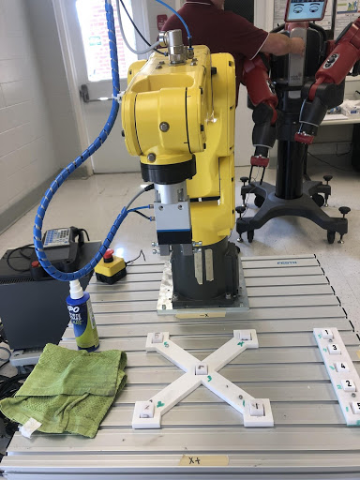
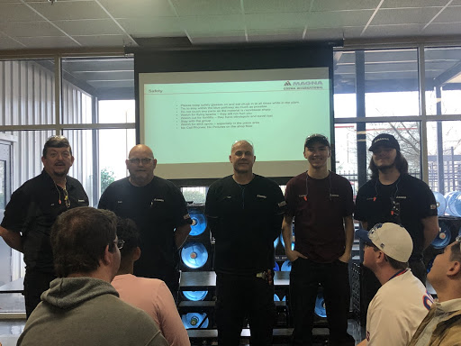
ROBOTICS
Students gain knowledge and skills needed in areas like mechanics, electronics, computer science, process controls, drone construction/programming, and robotics.
Students must enjoy math and have an aptitude for it.
Possible certifications/credentials: MSSC Safety and Maintenance
All four classes taught in this program can earn you college credit at local community colleges.
The median salary in Alabama is $113,200. Salaries start at $63,900 and can reach $153,290 or higher.

Slide 16
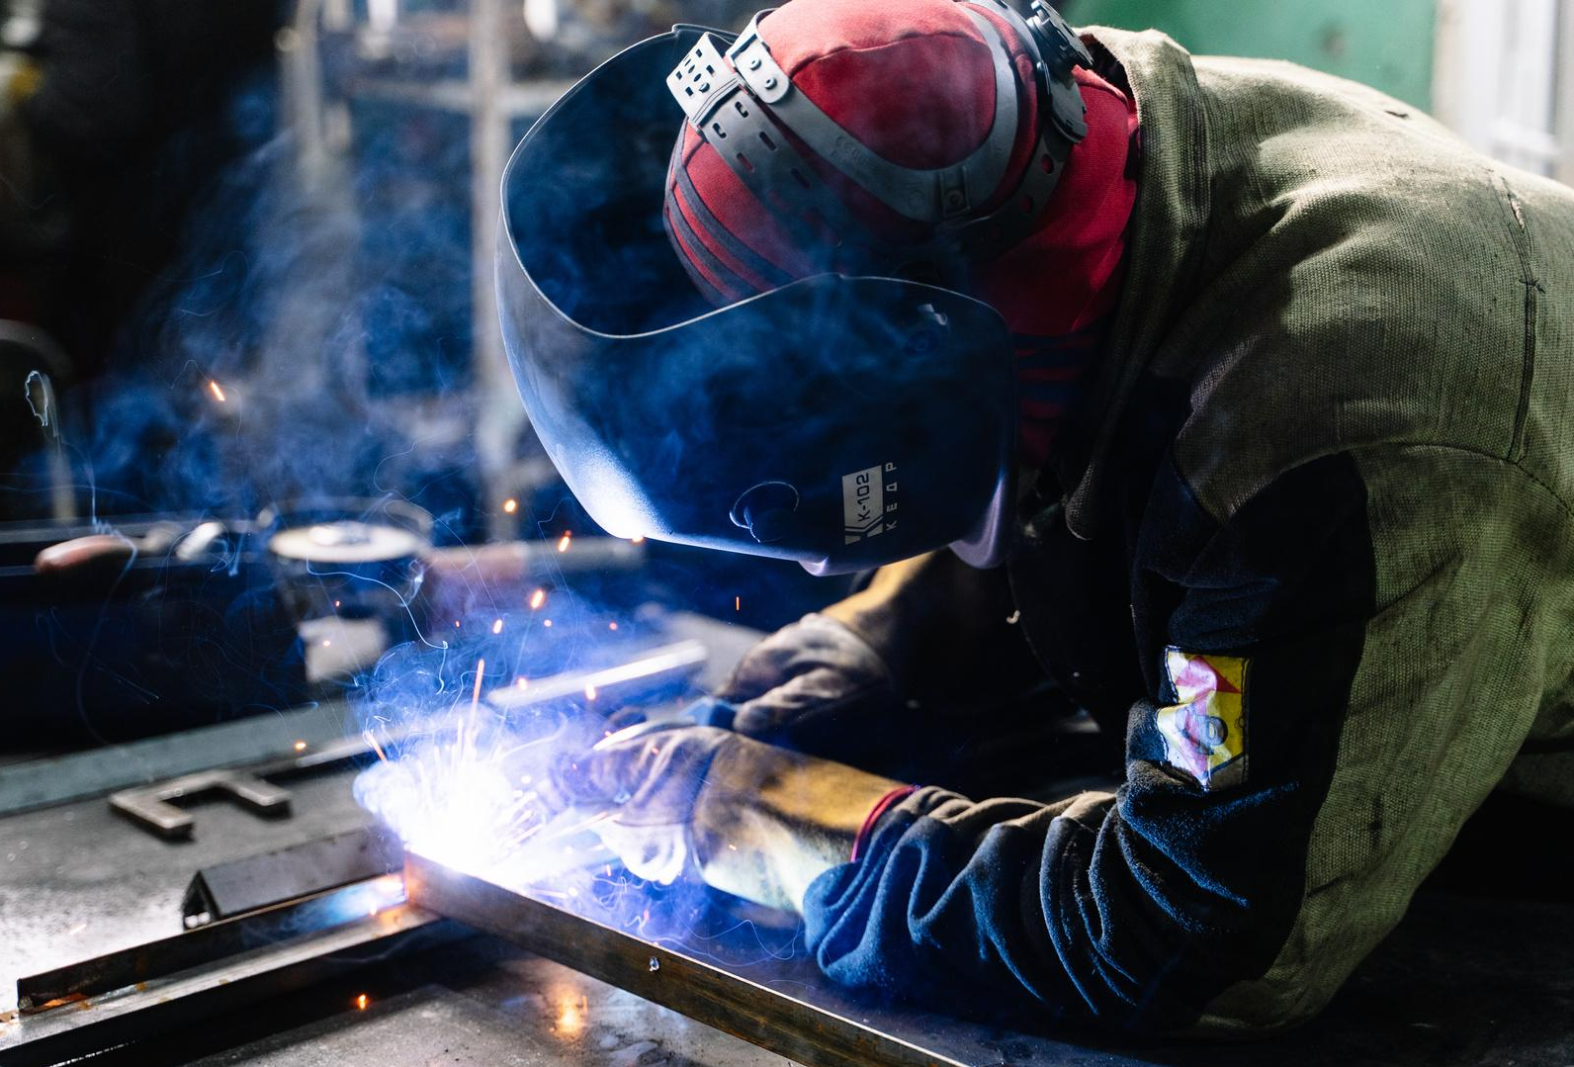
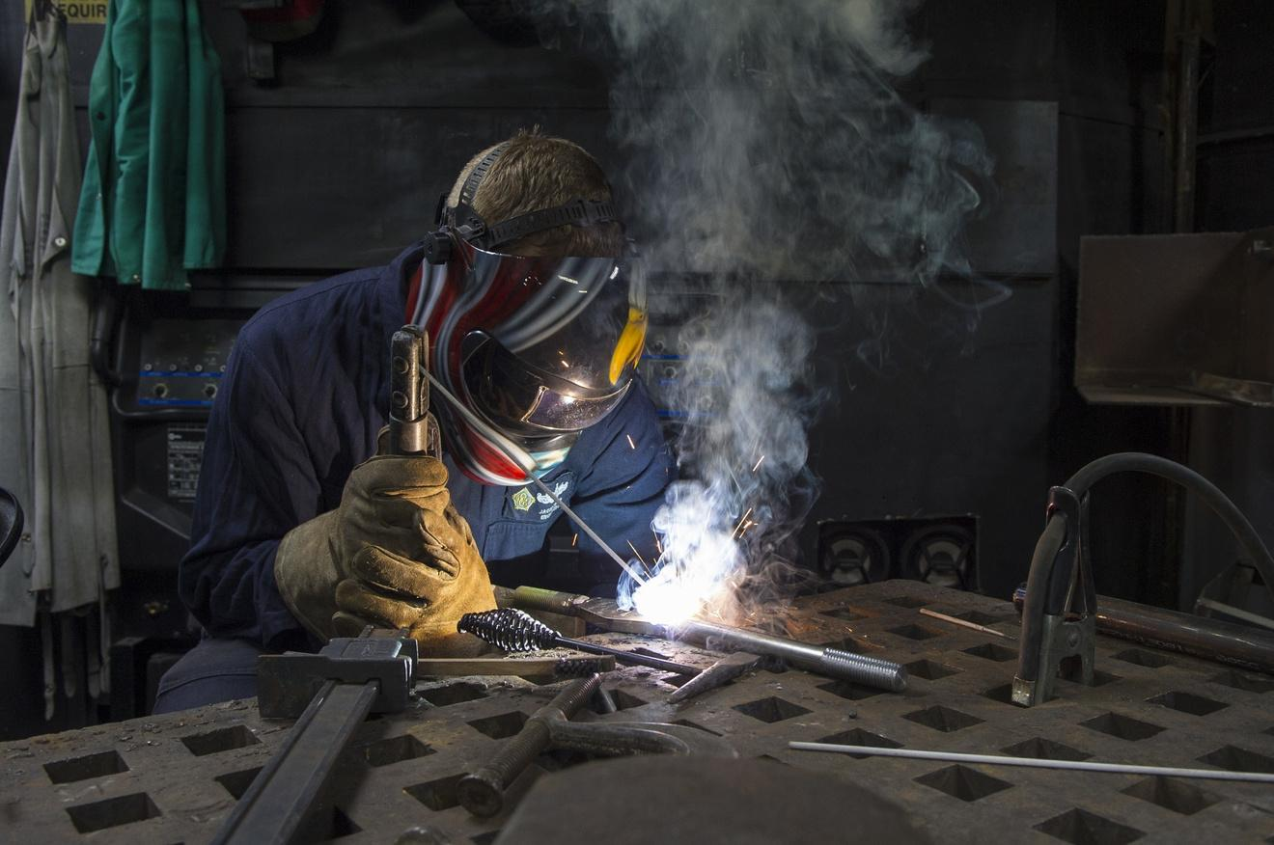
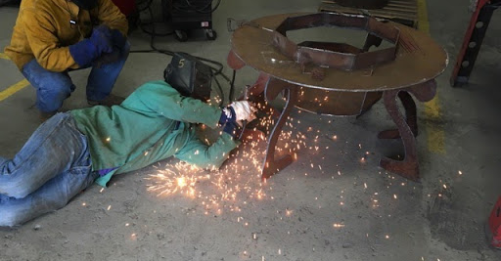
WELDING
Students learn how to permanently join metals together using electricity and other heat sources. Students also learn how to set up and operate cutting/welding equipment, and other types of machines according to industry standards.
Possible certifications/credentials: OSHA 10 card, NCCER credential in Welding and several other American Welding Society certifications are available through the program as well.
Alabama’s median salary is $35,920. The salary ranges from $24,140 to $52,190. Underwater welders start out around $60,000 and average over $86,000.

Slide 17
QUESTIONS
Who should apply? Students typically apply in the 10th grade and come to CTEC 11th/12th grade.
Where is CTEC located and how do I get there? We are located in Columbiana and you can ride the bus or drive.
How much does it cost? It depends on the program but fees don’t have to be paid until you start the program.
Will I miss my other classes? You will not miss any classes, CTEC is part of your schedule. 1st year students come in the morning and 2nd year students come in the afternoon. Depending on which school that you are at, you may just do your core classes at your home school.
What about sports or band? It is up to your sponsor if you can do both, it depends on if it will fit into your schedule.
What are the requirements? You must have already completed health/career prep and be on track to graduate. There are specific GPA requirements for some programs.
Can I be a remote learner and still come to CTEC? This year, all CTEC programs are in person but students can do their other classes virtually. I am not sure what will be allowed for 21-22.
How do I apply? Our link is posted on our website (Career Technical Educational Center). CTEC Application

Slide 18
RESOURCES
CTEC
CTEC Application 20-21
Construction Trading Cards
Construction Demand by State Demand by State
Which Construction Career Best Suits You?
Innovate Birmingham
Choose a Career Based on Your Favorite Toys as a Kid
Top 40 Jobs in Alabama That Don't Require a Degree
Top 40 Hot Jobs in Alabama

