Slide 1
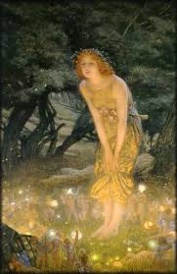
Funky Fungus
Facts & Folklore

Slide 2
According to archaeologists, people have been enjoying the products of fungal fermentation—wine and beer—for at least 25,000 years

Slide 3
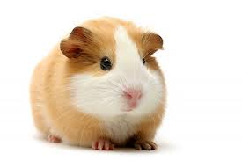
If the scientists who developed penicillin had tested it on guinea pigs instead of mice, they might have given up their quest. Penicillin is toxic to guinea pigs and would have killed them

Slide 4
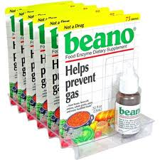
The active ingredient in Beano®-the wind-reducing standby of the flatulent-is an enzyme derived from the mould Aspergillus niger

Slide 5
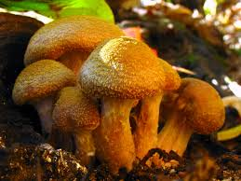
The largest living organism on earth may be a fungus. A culture of the species Armillaria bulbosa has spread through an 86-hectare (35 acre) woodland in northern Michigan. It could be 1,500 years old

Slide 6
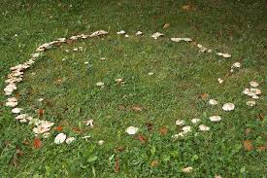
England, as their name suggests, they were places where fairies come to dance. The mushrooms around the perimeter were seats where the sprites could rest after their exertions. People in rural England claimed to have seen fairies dancing at fairy rings as recently as the start of the twentieth century.

Slide 7
One common theme in all these traditions is the belief that dire consequences await anyone foolhardy enough to enter a fairy ring. Trespassers would be struck blind or lame, or even disappear to become slaves in the fairies' underground realm. In Wales the rings were associated with fertility and doom, and anyone foolish enough to plow one up would incur the wrath of the fairies. It was also widely believed that if animals grazed within a fairy ring their milk would putrefy.

Slide 8
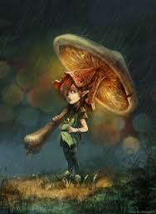
In parts of Central America a children's tale relates that mushrooms are little umbrellas carried by woodland spirits to shelter them from the rain. The spirits leave the mushrooms behind at dawn when it is time to return to their underground world.

Slide 9
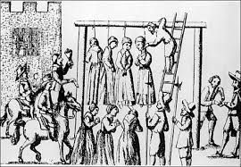
Between the sixteenth and nineteenth centuries, people in rural areas of central Europe would exhibit strange symptoms from time to time—dementia, facial distortions, hallucinations, convulsions, and paralysis. Cattle would stop producing milk, and other farm animals would also behave strangely. On many occasions these people were persecuted by religious zealots, tried as witches, and subjected to the cruellest of tortures. Thousands were executed in the name of Christianity.

Slide 10
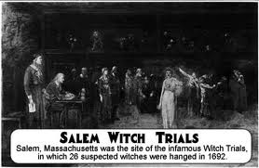
We now know that these people were not possessed by evil spirits, but were exhibiting signs of ergot poisoning, after eating bread made from rye contaminated with the fungus Claviceps purpurea. Most 'bewitchments' took place in the cool, damp river valleys of southwestern Germany and southeastern France, where conditions were perfect for ergot to thrive and rye was a staple cereal crop. Nearly 300 years after the notorious witchcraft trials in Salem, Massachusetts of 1692, there is compelling evidence that the accused in this case were also suffering from ergotism. The symptoms were again consistent with poisoning. Damp and rainy weather conditions recorded at the time were also ideal for ergot. The weather the following summer was drier—and the bewitchments abruptly ended.

