Slide 1
Making Rigor Common in a Language Arts Class
Ramp up your class activities and develop stronger relationships with your students! See how concept-based learning, multiple intelligences and interest inventories create positive relationships and engage students intellectually, socially, emotionally and behaviorally in learning. This session will also cover Socratic circles, inquire-based reading, pre-AP strategies, technology and writing.
Sherri Spears
Language Arts Teacher
Chelsea Middle School
Chelsea, Alabama
SSPEARS@SHELBYED.K12.AL.US

Slide 2
Pig PERSONALITY TEST
Only you will judge
your artwork…

Slide 3
Draw a pig

Slide 4
Pig personality test results
If your pig is drawn toward the Top of your paper, you are an optimistic person with a positive attitude. You generally anticipate the best possible outcomes of actions and events. In other words, you see the glass as half full.
If your pig is drawn toward the Bottom of your paper, you tend to be more of a pessimistic person. You generally expect the worst. You see the glass as half empty.
If your pig is drawn toward the Middle of your paper, you are a realist who tends to face facts and deal with them realistically. You see the glass as dirty and put it in the dishwasher.

Slide 5
Pig personality test results
If your pig is drawn facing Left, you believe in tradition, are friendly, outgoing and tend to remember dates and birthdays. Hint for husbands: remember your wife's birthday but never her age.
If your pig is drawn facing Right, you are innovative and active but not as good about remembering dates.
If your pig is drawn facing Forward, you are direct, straightforward, welcome discussion, and often enjoy playing the devil's advocate.

Slide 6
Pig personality test results
7. If your pig is drawn with Many Details, you are analytical, cautious, careful and may be distrustful.
8. If your pig is drawn with Few Details, you are more impulsive, care little for detail and are willing to take risks.
9. If your pig is drawn with 4 Legs showing, you are secure, stick to your ideals, and can be stubborn.
10. If your pig is drawn with Less than 4 Legs showing, you may be insecure, uncertain, or living through a period of major change.

Slide 7
Pig personality test results
11. The Larger the pig's Ears you have drawn, the better Listener you are.
12. And last but not least, the Longer the pig's Tail you have drawn, the more satisfied you are with the quality of your love life.

Slide 8
Multiple intelligences in the classroom
There are several benefits to using the multiple intelligences theory in the classroom

Slide 9
1. Activities such as drawing a picture, listening to or composing music, watching a performance and more are vital gateways to learning. Tests show that students who do unsuccessfully on conventional exams become more interested in learning when classroom experiences incorporate artistic, athletic, and musical activities.

Slide 10
1. Activities such as drawing a picture, listening to or composing music, watching a performance and more are vital gateways to learning. Tests show that students who do unsuccessfully on conventional exams become more interested in learning when classroom experiences incorporate artistic, athletic, and musical activities.
2. You will provide chances for true learning based on the students' needs, interests and talents. Students become more active and involved learners.

Slide 11
1. Activities such as drawing a picture, listening to or composing music, watching a performance and more are vital gateways to learning. Tests show that students who do unsuccessfully on conventional exams become more interested in learning when classroom experiences incorporate artistic, athletic, and musical activities.
2. You will provide chances for true learning based on the students' needs, interests and talents. Students become more active and involved learners.
3. Parent and family involvement in the school may increase. This would happen as students exhibit work before an audience. This process brings members of the community into the learning process.

Slide 12
1. Activities such as drawing a picture, listening to or composing music, watching a performance and more are vital gateways to learning. Tests show that students who do unsuccessfully on conventional exams become more interested in learning when classroom experiences incorporate artistic, athletic, and musical activities.
2. You will provide chances for true learning based on the students' needs, interests and talents. Students become more active and involved learners.
3. Parent and family involvement in the school may increase. This would happen as students exhibit work before an audience. This process brings members of the community into the learning process.
4. Students will be able to display and show off their strengths. Building a child's strengths gives the child the incentive to be a "specialist" which can lead to increased self-esteem.

Slide 13
1. Activities such as drawing a picture, listening to or composing music, watching a performance and more are vital gateways to learning. Tests show that students who do unsuccessfully on conventional exams become more interested in learning when classroom experiences incorporate artistic, athletic, and musical activities.
2. You will provide chances for true learning based on the students' needs, interests and talents. Students become more active and involved learners.
3. Parent and family involvement in the school may increase. This would happen as students exhibit work before an audience. This process brings members of the community into the learning process.
4. Students will be able to display and show off their strengths. Building a child's strengths gives the child the incentive to be a "specialist" which can lead to increased self-esteem.
5. Students gain the positive educational experiences and the ability for establishing solutions to problems in life. This occurs when the educator "teaches for understanding."
2004 Educational Broadcasting Corporation

Slide 14
6. The students develop increased responsibility, self-direction and independence over the course of the year.

Slide 15
6. The students develop increased responsibility, self-direction and independence over the course of the year.
7. Discipline problems are significantly reduced.

Slide 16
6. The students develop increased responsibility, self-direction and independence over the course of the year.
7. Discipline problems are significantly reduced.
8. All students developed and applied new skills.

Slide 17
6. The students develop increased responsibility, self-direction and independence over the course of the year.
7. Discipline problems are significantly reduced.
8. All students developed and applied new skills.
9. Cooperative learning skills improved in all students. Since so much of the MI work is collaborative, students become highly skilled at listening, helping each other, sharing leadership in different activities, accommodating group changes, and introducing new classmates to the program.

Slide 18
6. The students develop increased responsibility, self-direction and independence over the course of the year.
7. Discipline problems are significantly reduced.
8. All students developed and applied new skills.
9. Cooperative learning skills improved in all students. Since so much of the MI work is collaborative, students become highly skilled at listening, helping each other, sharing leadership in different activities, accommodating group changes, and introducing new classmates to the program.
10. Academic achievement improved.
---Dr. Howard Gardner

Slide 19
Multiple intelligence learning centers

Slide 20
In the Personal Work Center (Intrapersonal Intelligence), students explore the present area of study through research, reflection, or individual projects.
In the Working Together Center (Interpersonal Intelligence), they develop cooperative learning skills as they solve problems, answer questions, create learning games, brainstorm ideas and discuss that day’s topic collaboratively.
In the Music Center (Musical Intelligence), students compose and sing songs about the subject matter, make their own instruments, and learn in rhythmical ways.
In the Art Center (Spatial Intelligence), they explore a subject area using diverse art media, manipulatives, puzzles, charts, and pictures.
In the Building Center (Kinesthetic Intelligence), they build models, dramatize events, and dance, all in ways that relate to the content of that day’s subject matter.
In the Reading Center (Verbal/Linguistic Intelligence), students read, write, and learn in many traditional modes. They analyze and organize information in written form.
In the Math & Science Center (Logical/ Mathematical Intelligence), they work with math games, manipulatives, mathematical concepts, science experiments, deductive reasoning, and problem solving.

Slide 21
Concept-Based Learning
Beliefs
Decision and Consequences
Perspectives

Slide 22
Concept: beliefs
Guiding Questions:
What is your belief about a situation?
Why is it important to understand other beliefs?
How do your beliefs change?
How do beliefs influence decisions?
Essential Understandings:
Different people have different beliefs.
Understanding various beliefs helps with understanding of a situation.
Beliefs may change over time.
Beliefs may dictate a person’s actions, words, or decisions.

Slide 23
Concept: decisions and consequences
Guiding Questions:
Why do the decisions we make require living with the consequences?
What affects the decisions we make or the consequences we suffer?
How can you make better decisions?
How do we show responsibility when making decisions?
What actions can be taken to remedy poorly made decisions?
Are all consequences bad?
Essential Understanding:
Decisions and their consequences impact our futures.
Decisions have consequences.
Consequences may follow as a logical conclusion or inference and may be logically consistent.
Decisions should be affected by personal goals.
Wisdom comes by analyzing the consequences of our decisions.

Slide 24
Concept: perspectives
Guiding Questions
Why do diverse people interpret issues and events differently?
How do different perspectives effect actions and interactions?
What leads to conflict, cooperation, and interdependence among individuals, groups, societies, and nations?
How do differing perspectives lead to conflict?
Essential Understanding
Experience and background knowledge influence perspective.
Perspectives can change.
Evaluating and understanding perspectives allow for better interpretation of shared information.
Differing perspectives lead to different interpretations and may cause conflict.

Slide 25
Reading
“We read to know
we are not alone.”
-C.S. Lewis

Slide 26
Quotes:
No matter how busy you may think you are, you must find time for reading, or surrender yourself to self-chosen ignorance.” –Confucius
“Reading without reflecting is like eating without digesting.” – Edmund Burke
“The man who does not read good books has no advantage over the man who can’t read.” – Mark Twain

Slide 27
Tips for motivating students to read
Here are suggestions for motivating students that author Deborah Reed has used and drawn from numerous sources.
Offer students choice in their reading materials.
Ask your librarian to give book chats
Have students make book trailers to encourage classmates to read a selected title (show the trailers at the start of class throughout the year)
Arouse curiosity of books by previewing them with students, activating students' prior knowledge, connecting the book to students' lives or to popular culture, and helping students make predictions about possible outcomes.

Slide 28
Tips for motivating students to read
Allow students to respond to their reading through discussion with both peers and adults, through reflective writing, or both.
Frequently and explicitly model reading, responding, and monitoring comprehension.
Reduce the number of activities associated with the book to focus more on the reading itself and foster an aesthetic stance (as opposed to an efferent stance where students read to carry away information).
Ensure opportunities for students' success by assigning tasks that are neither too easy nor too difficult.
Give frequent, early, positive feedback that supports students' beliefs that they can do well.

Slide 29
Tips for motivating students to read
Use positive emotions to enhance learning and motivation. Strong and lasting memory is connected with the emotional state and experience of the learner. That is, people remember better when the learning is accompanied by strong emotions. If you can make something fun, exciting, happy, loving, or perhaps even a bit frightening, students will learn more readily and the learning will last much longer. Emotions can be created by classroom attitudes, by doing something unexpected or outrageous, by praise, and by many other means.

Slide 30
Developing critical thinking through close reading skills

Slide 31
Developing critical thinking
Question: How do you currently encourage close reading of texts?
Question: What are some of the attributes characteristic of strong readers or thinkers?
Metacognition—they think about their thinking
They use background knowledge
They make connections
They visualize
They ask questions
They make inferences
They make predictions
The evaluate and challenge the text/author/ideas
They create new understandings—synthesize

Slide 32
We want them to be challenged – not defeated!
Provide them
with the tools to
learn how to think critically.

Slide 33
Types of reading strategies
Inquiry Based Reading
SOAPSTone
5-S Strategy
Socratic Circles
Fishbowl Discussions (outer circles asks questions/inner circle answers)
RAFT
Paraphrase X 3
Dialectical Journal
It Says, I Say
Literature Circles

Slide 34
What the research shows
When students read what they want to read, they are more engaged in the material and chances are that if something interests them, they’re more like to put effort into learning about that topic, designing projects which reflect that learning, and without even realizing it, they’ll be developing related skills along the way.
Middle school teachers who used an inquiry approach increased the achievement scores of African American students, narrowed the achievement gap between male and female students, and found that their students were more interested in what they had to teach.
Kahle, J. B., J. Meece, and K. Scantlebury. 2000. Urban African-American middle school science students: Does standards-based teaching make a difference? Journal of Research in Science Teaching 37 (9):1019-1041.

Slide 35
What the research shows
A study involving over 1400 students found that inquiry-based approaches in middle and high school language arts classrooms allow both low- and high-achieving students to make academic gains.
Applebee, Arthur N., Judith A. Langer, Martin Nystrand and Adam Gamoran. 2003. Discussion-Based Approaches to Developing Understanding: Classroom Instruction and Student Performance in Middle and High School English. American Educational Research Journal 40 (3): 685-730.
Unfortunately, our traditional educational system has worked in a way that discourages the natural process of inquiry. Students become less prone to ask questions as they move through the grade levels. In traditional schools, students learn not to ask too many questions, instead to listen and repeat the expected answers.

Slide 36
Inquiry-based close reading

Slide 37
Inquiry-based close reading
Objective: to equip students with strategies for reading and analyzing text by using different levels of thinking, especially literal, critical, inferential, and analytical
Material: any work—poem, short story, excerpt, cartoon, video, editorial, etc.
“Learners need to develop critical thinking skills in order to engage in higher-level knowledge construction. One way this can be taught is by using a series of question that actively engage readers during the reading of a text (relates to directly to Blooms)

Slide 38
Step 1. Choose a text for students to read. Make it relatively easy
While reading:
Highlight main ideas
Question yourself and the text
Connect to prior knowledge
Reread for better understanding
Make notes in margin
Use context clues
Make personal symbols or notes

Slide 39
Step 2.
Ask students to work together to come up with questions for each level of thinking. They need to use their annotations (from Step 1) to help develop questions.
Knowledge/Remember questions refer to the ability to locate the main idea, and understand the sequential order of events.
What is the main idea?
What happened first, second, third, and finally?
Comprehension/Understand questions refer to the skills of recognizing cause and effect, making predictions, and summarizing.
Tell one thing that happened. What was the cause?
Based on the text, what do you think will happen next?
Summarize what you have read in three sentences.

Slide 40
Application/Apply/Demonstrate questions refer to the skills of using context clues to identify new word meaning and interpreting figurative language.
How did context clues help you find the meaning of a new word?
Provide an example of figurative language from what you are reading and explain its meaning.
Analysis/Analyze questions refer to the skills of differentiating between fact and opinion, comparing and contrasting, drawing conclusions, making inferences, and determining author’s purpose
Name one fact and one opinion and identify how they are different
Compare and contrast what you are reading now to something you’ve read before
What is a conclusion you are able to draw from what you just read? Cite evidence.
Using clues from the text, what is something you can infer? Cite evidence.
What is the author’s purpose for what you are reading? Cite evidence.

Slide 41
Step 3: Ask the students to document any images, symbols, words, or phrases that prompted question generation.
Step 4: Allow the students to discuss questions and connections in small groups or as a whole class.

Slide 42
SOAPSTone
Use it to analyze reading, but allow students to use it as organization for composition.

Slide 43
Reading:
Who is the SPEAKER? (Remember that it is not enough simply to name the speaker. What can you say about the speaker based on references from the text?)
What is the OCCASION? (Be certain to discuss and record both the larger occasion, that is, those issues or ideas that must have made the speaker think about this incident, as well as the immediate occasion, whatever made the speaker decide to include this incident.)
Who is the AUDIENCE? (To whom is the text directed? It’s not enough to answer: ”Anyone who reads it.” You will want to identify a certain audience by describing some of its characteristics.)
What is the PURPOSE? (The purpose could be purely a personal one, e.g., to assuage guilt, to boast, to reminisce. But it could also be directed at the audience, in which case you will have to decide what the message is and how the author wants the audience to respond.)
What is the SUBJECT? (You should be able to state the subject in a few words or a very short phrase.)
What is the TONE? (Try to choose a description of the tone that fits the piece as a whole. You must also include specific words and phrases from the text and explain how they support your statement.)

Slide 44
composition
SOAPSTone (Speaker, Occasion, Audience, Purpose, Subject, Tone) is an acronym for a series of questions that students must first ask themselves, and then answer, as they begin to plan their compositions.

Slide 45
Who is the Speaker?
The voice that tells the story. Before students begin to write, they must decide whose voice is going to be heard. Whether this voice belongs to a fictional character or to the writers themselves, students should determine how to insert and develop those attributes of the speaker that will influence the perceived meaning of the piece.
What is the Occasion?
The time and the place of the piece; the context that prompted the writing. Writing does not occur in a vacuum. All writers are influenced by the larger occasion: an environment of ideas, attitudes, and emotions that swirl around a broad issue. Then there is the immediate occasion: an event or situation that catches the writer's attention and triggers a response.
Who is the Audience?
The group of readers to whom this piece is directed. As they begin to write, students must determine who the audience is that they intend to address. It may be one person or a specific group. This choice of audience will affect how and why students write a particular text.

Slide 46
What is the Purpose?
The reason behind the text. Students need to consider the purpose of the text in order to develop the thesis or the argument and its logic. They should ask themselves, "What do I want my audience to think or do as a result of reading my text?"
What is the Subject?
Students should be able to state the subject in a few words or phrases. This step helps them to focus on the intended task throughout the writing process.
What is the Tone?
The attitude of the author. The spoken word can convey the speaker's attitude and thus help to impart meaning through tone of voice. With the written word, it is tone that extends meaning beyond the literal, and students must learn to convey this tone in their diction (choice of words), syntax (sentence construction), and imagery (metaphors, similes, and other types of figurative language). The ability to manage tone is one of the best indicators of a sophisticated writer.
--Borrowed from Ogden Morse

Slide 47
The 5-S strategy
Sentences
Speaker
Situation
Shifts
Syntax

Slide 48
The 5-s strategy
Sentences-Discover the key sentences. Read the first and last sentence of the passage, skim the middle, and then read the whole thing.
Speaker-Discover the speaker. Look for the number of speakers and the narrator’s point of view. Note anything that gives a clue about the speaker’s tone.
Situation-Discover the situation. What is happening? State the situation in one clear sentence.
Shifts-Discover the shifts. Find the big changes in the way the sentences are put together, the way the words are used, and the way the writer changes what he or she is saying. Find areas of the passage where you can locate the most changes, and closely annotate them. You need to look for changes in (syntax, diction, connotation, denotation, tone, sentence length, rhythm, punctuation, or patterns of imagery).

Slide 49
The 5-s strategy
Syntax- Discover the significant syntax. Syntax is the diction that is chosen and the way it is put together. Look for changes in sentence length, order, use of punctuation, and typographical elements such as italics, sentence inversion, etc. Syntax is the way the writer reveals him or herself through the use of words and sentence structure. Identifying this syntax will often guide the reader to the part of the passage that conveys the most meaning—the crux.
Count the number of words.
How many independent clauses?
Can you count unusual punctuation…/-/?/!
Look for conjunctions (and, yet, but, or, nor, for)
Polysyllabic words
Prepositional phrases in unusual places
Parallel structures
Comparisons made (similies or metaphors)
How many figurative language elements?
Various types of diction

Slide 50
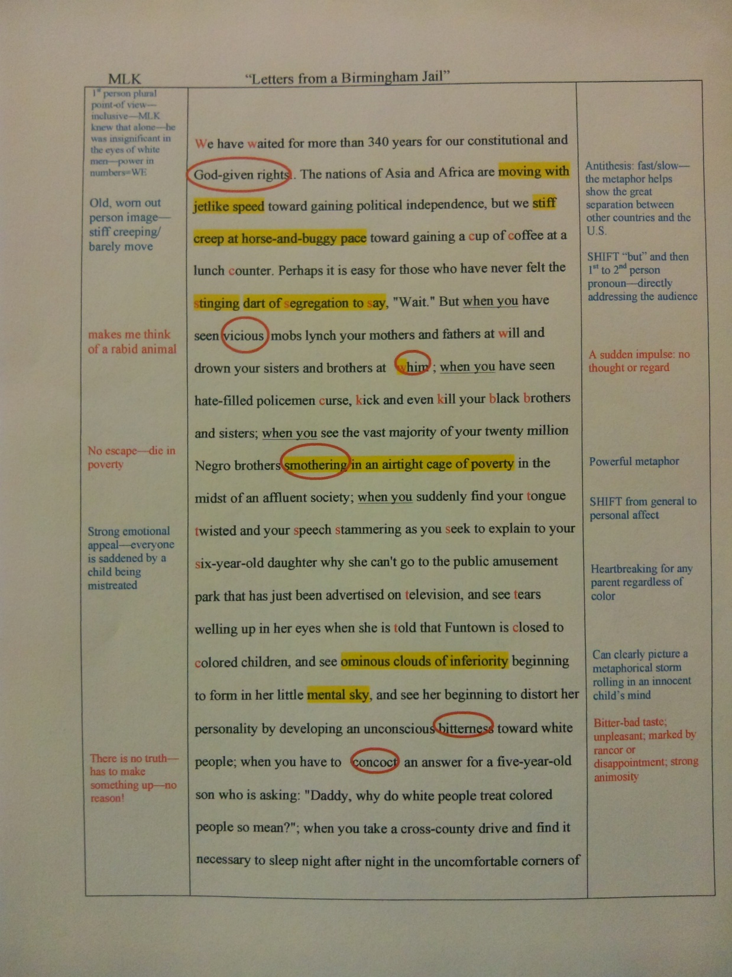

Slide 51
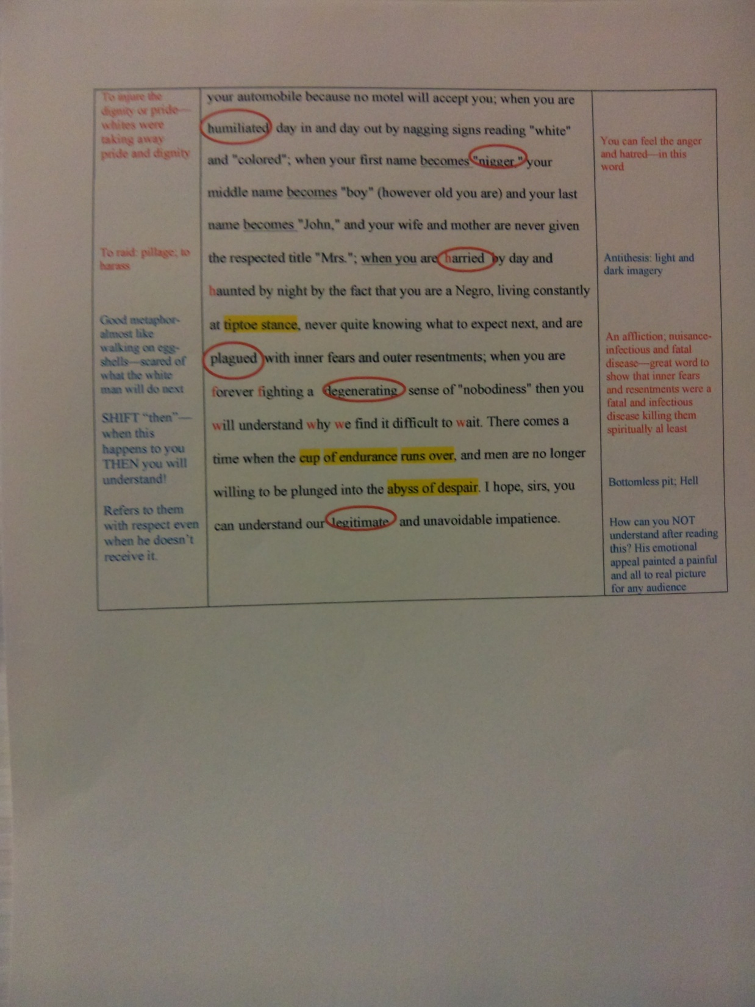

Slide 52
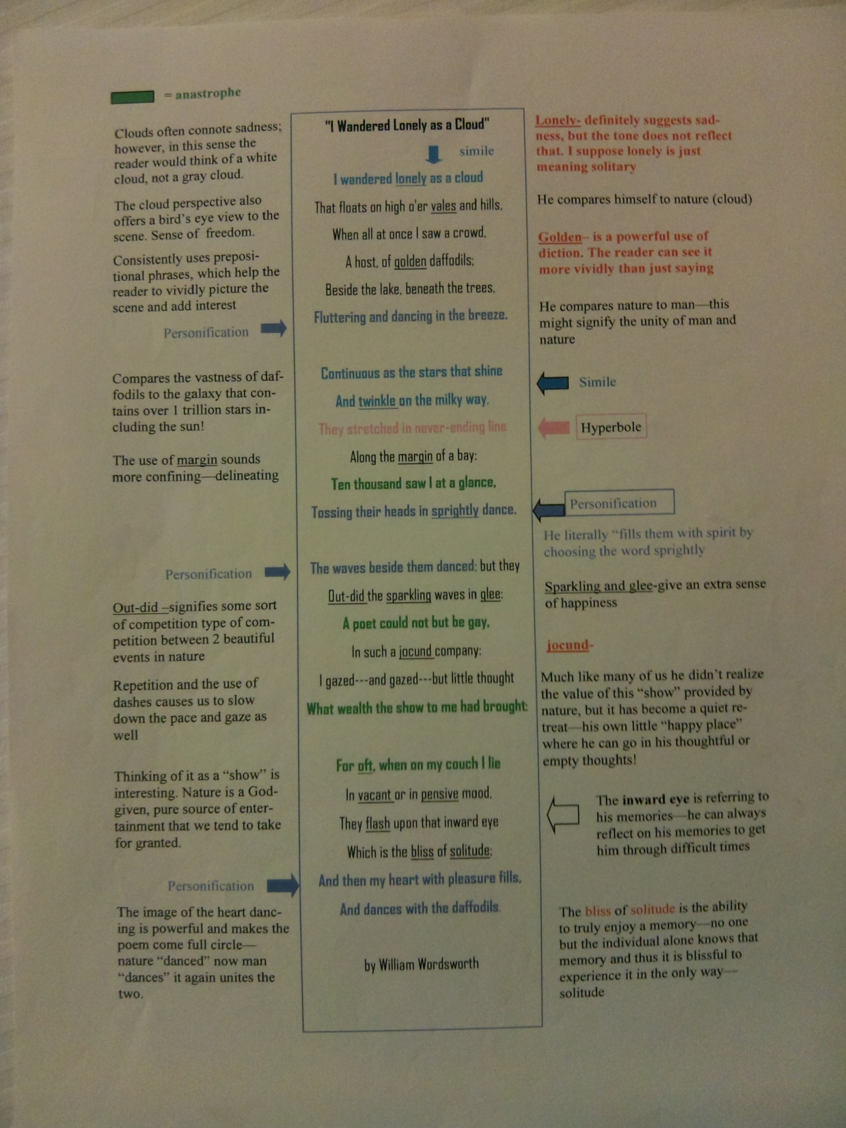

Slide 53
Writing

Slide 54
Collins Writing
Embraces the revision process
So many times we rush through & fail to truly “teach the revision process” or model it!
The beauty of writing is in the revision process, that’s when we are really learning!
If we grade everything the sea of red/green is overwhelming!
Research proves that students learn and improve by focusing on specific “small” areas of difficulty
FCA’s – Focus Correction Areas – allow for objective grading.

Slide 55
Continued…
Have to allow for consistent practice of writing.
The first time students are asked to write about their learning shouldn’t be on a test/final.

Slide 56
DON’T GRADE EVERY ASPECT OF A PAPER
Kids feel like failures
Scared to perform
If you haven’t taught the student every skill of composition, why should you grade for every skill?
Research proves that students learn and improve their writing when they know what to expect. They feel safe and more willing to perform.
Students become overwhelmed with the sea of red ink and can’t identify where to improve. Small areas of focus allows a student to master skills and move on to more skills.
Easier and quicker to grade

Slide 57
FCA’S
FCA’s are skills that you have TAUGHT the student
FCA’s are the ONLY items that can be graded in an essay
FCA’s can be ANY skill you want to measure as long as you have TAUGHT the skill
FCA’s can be given any point value
FCA’s should always be identified by the STUDENT
When grading the FCA’s, you MUST use specific feedback .
When an FCA is mastered move on to another set.

Slide 58
USELESS FEEDBACK
“Great job!”
“Excellent”
“?????”
“WTF”

Slide 59
SPECIFIC FEEDBACK
“I loved the way you used anaphora to drive home your point. It was very effective.”
“You did a great job elaborating on your quotes. Your insight was clear and thorough.”
“Your topic focused on beliefs. How did you end up talking about your sister setting your hair on fire? You need to stick to your topic. Try using an outline or brainstorm for clarity.”
“Your narrative lacks strong verbs. Go back and identify 5 dead/weak verbs and revise your word choice.”

Slide 60
FIVE TYPES OF WRITING
The Collins Writing Program allows for multiple revisions and differentiated instruction. It promotes effective writing and revision skills and allows students and teachers to remain sane!

Slide 61
Type I Capture Ideas—writing gets ideas on paper
Timed
Require a minimum number of items or lines
Questions and/or guesses are permitted
Evaluated with a + or –
One Draft

Slide 62
Type II Respond Correctly
Type II writing shows knowledge or thoughts about a topic (understanding)
It is a correct answer to a specific question
Is NOT graded for mechanics
Graded as a quiz
One Draft

Slide 63
Type III Edit for FCAs
Meaningful content and meets 3 specific standards (FCA’s)
Is read out loud and reviewed
Meets the following criteria: completes the assignment, is easy to read, and meets the FCAs
Revisions and editing are done on the original
One Draft

Slide 64
Type IV Peer Edit for FCAs
Type III writing that is read out loud and critiqued by another
TWO drafts

Slide 65
Type V Publish
Writing is the students BEST possible piece
Multiple Drafts

Slide 66
ANOTHER STEP…
Another step to add to this is REFLECTION. When your students have their beautifully typed essays on their desks with perfect MLA format, have them pull out the colored pens and annotate their essay. This is quite fun to watch because most students are apprehensive to mark on their final copy (this serves as another reminder that all drafts can be improved). Ask them to find the best and worst part and explain why they liked it or what they struggled to explain. There is a rubric for them to work through in the writing folder on the website.

Slide 67
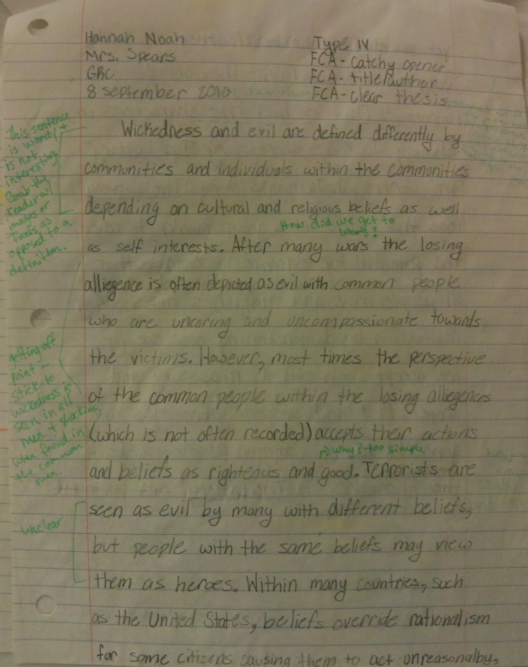

Slide 68
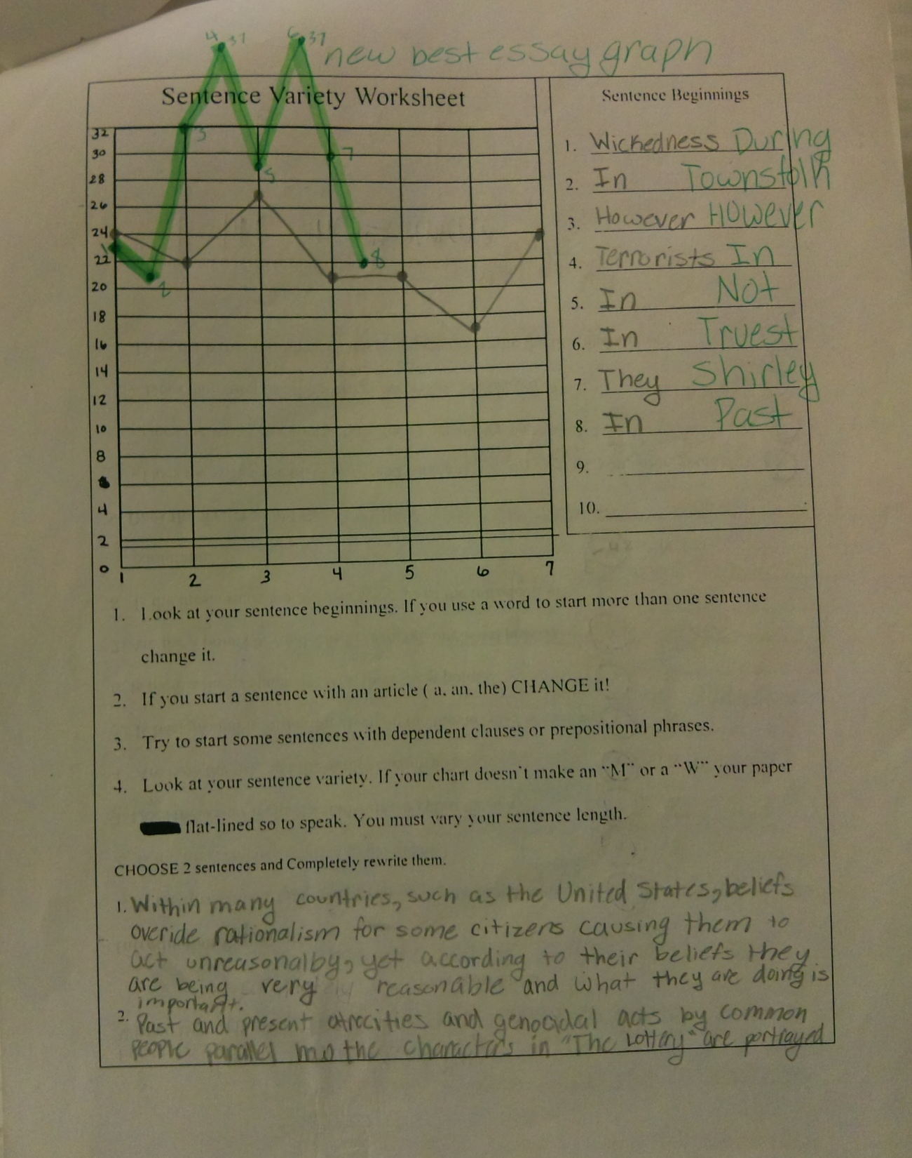

Slide 69
